Slide 1
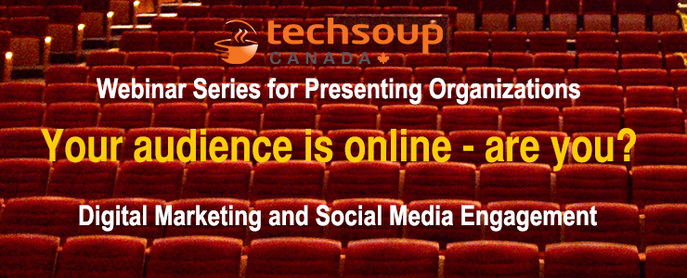

Slide 2


Webinar Series for Arts Presenters
Part 1: Thursday, March 20th:
  Digital marketing 101: What’s it all about?
Part 2: Tuesday, April 22nd:
  Digital marketing 101: What you need to know about websites
Part 3: Thursday, May 15th:
  Digital marketing 101: Being social with social media
Presented by:

Slide 3
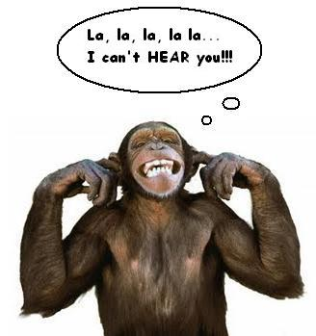
Reminder
You can hear us, but we can’t hear you!!

Slide 4

Webinar tips
Can’t hear?
  Try turning up your volume
  Call in or use headphones
Have a question? Use the Q&A box

Slide 5


Digital Marketing 101
What’s it all about?
March 20, 2014
with

Slide 6
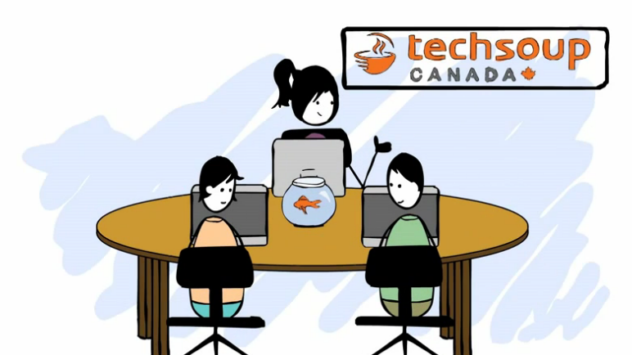
About TechSoup Canada
We help nonprofits use technology to achieve their full potential.
Register your organization today to be eligible to request over 300 products from 25 donor partners!
https://www.techsoupcanada.ca/en/support/how-to-register

Slide 7





Technology Donations Program
You may be eligible to get donations of…
Is my org eligible?
Does your business number end in RR0001?
Do you have a Letters Patent from Industry Canada?
Are you incorporated as a not-for-profit corporation with your province?
Are you a library?

Slide 8
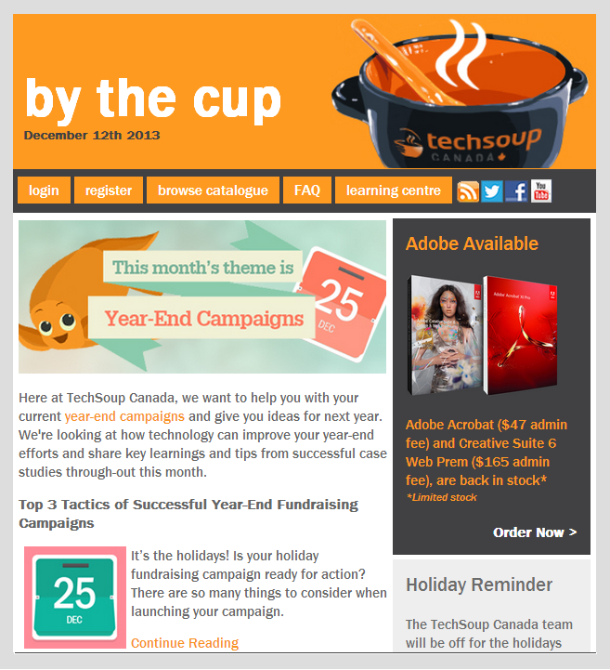
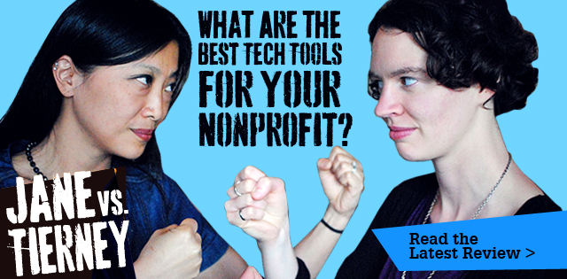



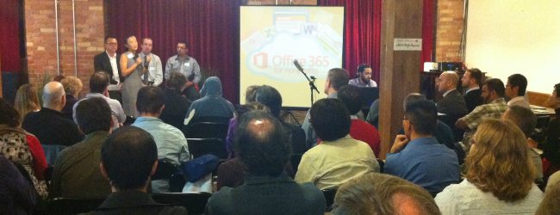
We create and curate tech resources
@techsoupcanada
facebook.com/
techsoupcanada
feeds.feedburner.com/
techsoupcanada

Slide 9
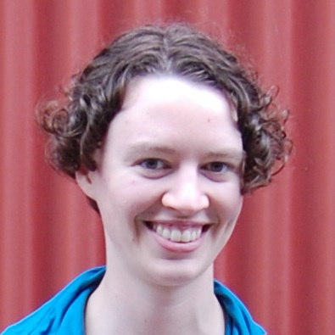
About Me
Tierney Smith
Program Manager at TechSoup Canada
@TierneyS

Slide 10
Agenda
Why should I be online?
Which channels are you playing on?
A brief review of marketing basics
Nitty gritty of your marketing plan
Q&A

Slide 11
Key takeaways
#1: Your audience is online -> you should be too
#2: Pick your channels & make them work together

Slide 12
Why should we be online?
Notes:
*** add speaking notes for this section for Joyce ***

Slide 13
Canadians are online!
83%
67%
41
hours
/month
Of Canadians use the Internet
Of them use social networking
Top sites are Facebook, Twitter, LinkedIn, Tumblr and Pinterest
Spent online
24.8 hours/month are spent just watching video!
All of these numbers are on a steady upwards trend!
Sources: 2012 Internet use - http://www.statcan.gc.ca/daily-quotidien/131028/dq131028a-eng.htm
http://theexchangenetwork.ca/upload/docs/Canada's%20Digital%20Future%20in%20Focus%202013.pdf

Slide 14
Who is online?
48%
63%
85%
Of Canadians aged 65 or older use the Internet – up from 40% in 2010
(This is the biggest increase of any age group)
Of low-income Canadians use the Internet, vs 95% of the wealthiest households
In metropolitan areas use the Internet, vs 75% outside these areas
More detailed stats: http://www.crtc.gc.ca/eng/publications/reports/policymonitoring/2013/cmr6.htm

Slide 15
Which Channels are you
Playing On?

Slide 16
Offline channels
Newspaper
Posters/bulletin boards
Radio
Word of mouth (can be online or offline)
Flyers in schools
Bridal/trade shows
Brochures
Venue programme

Slide 17
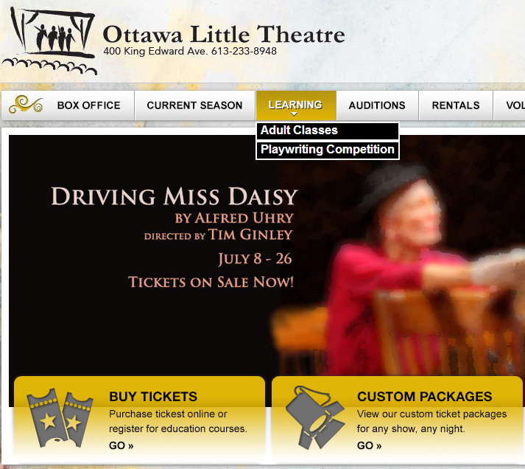
Website
Hub of your online presence
Demonstrates legitimacy
Recommended minimum content:
  Who you are
  Upcoming performances & venues
  Links to other online channels
  Contact info
Notes:
A Facebook page is not a substitute for a website

Slide 18
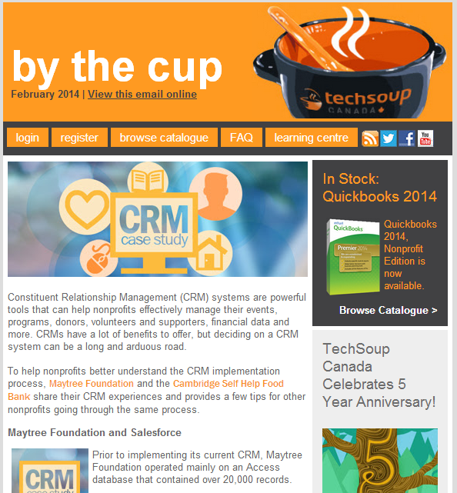
Email
Best way to communicate with your supporters
Use an email marketing service (e.g. MailChimp)
Mix visuals and text
Link back to more content/info on your website

Slide 19
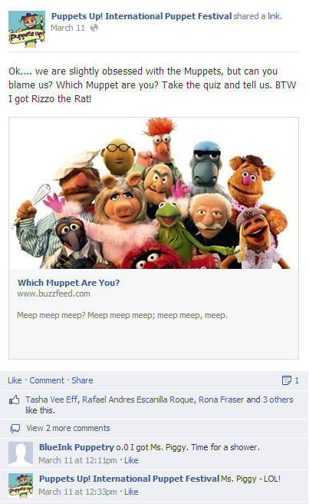
Social Media
Mostly for engagement, not promotion
Your best opportunity to have 2-way communication with your audience
Aim for deeper engagement on a few social media sites
Popular networks include Facebook, Twitter, YouTube, LinkedIn, Tumblr, Pinterest

Slide 20
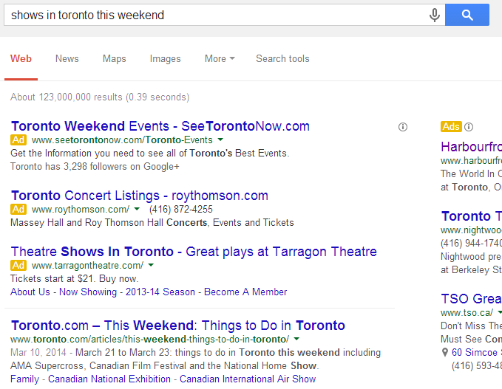
Online Advertising
Search engine marketing (SEM) = ads related to search engine keywords
  Google Adwords
  Google Grants (for charities)
Banner ads = ads on other websites
Social media advertising
  Mostly seen on Facebook and YouTube

Slide 21
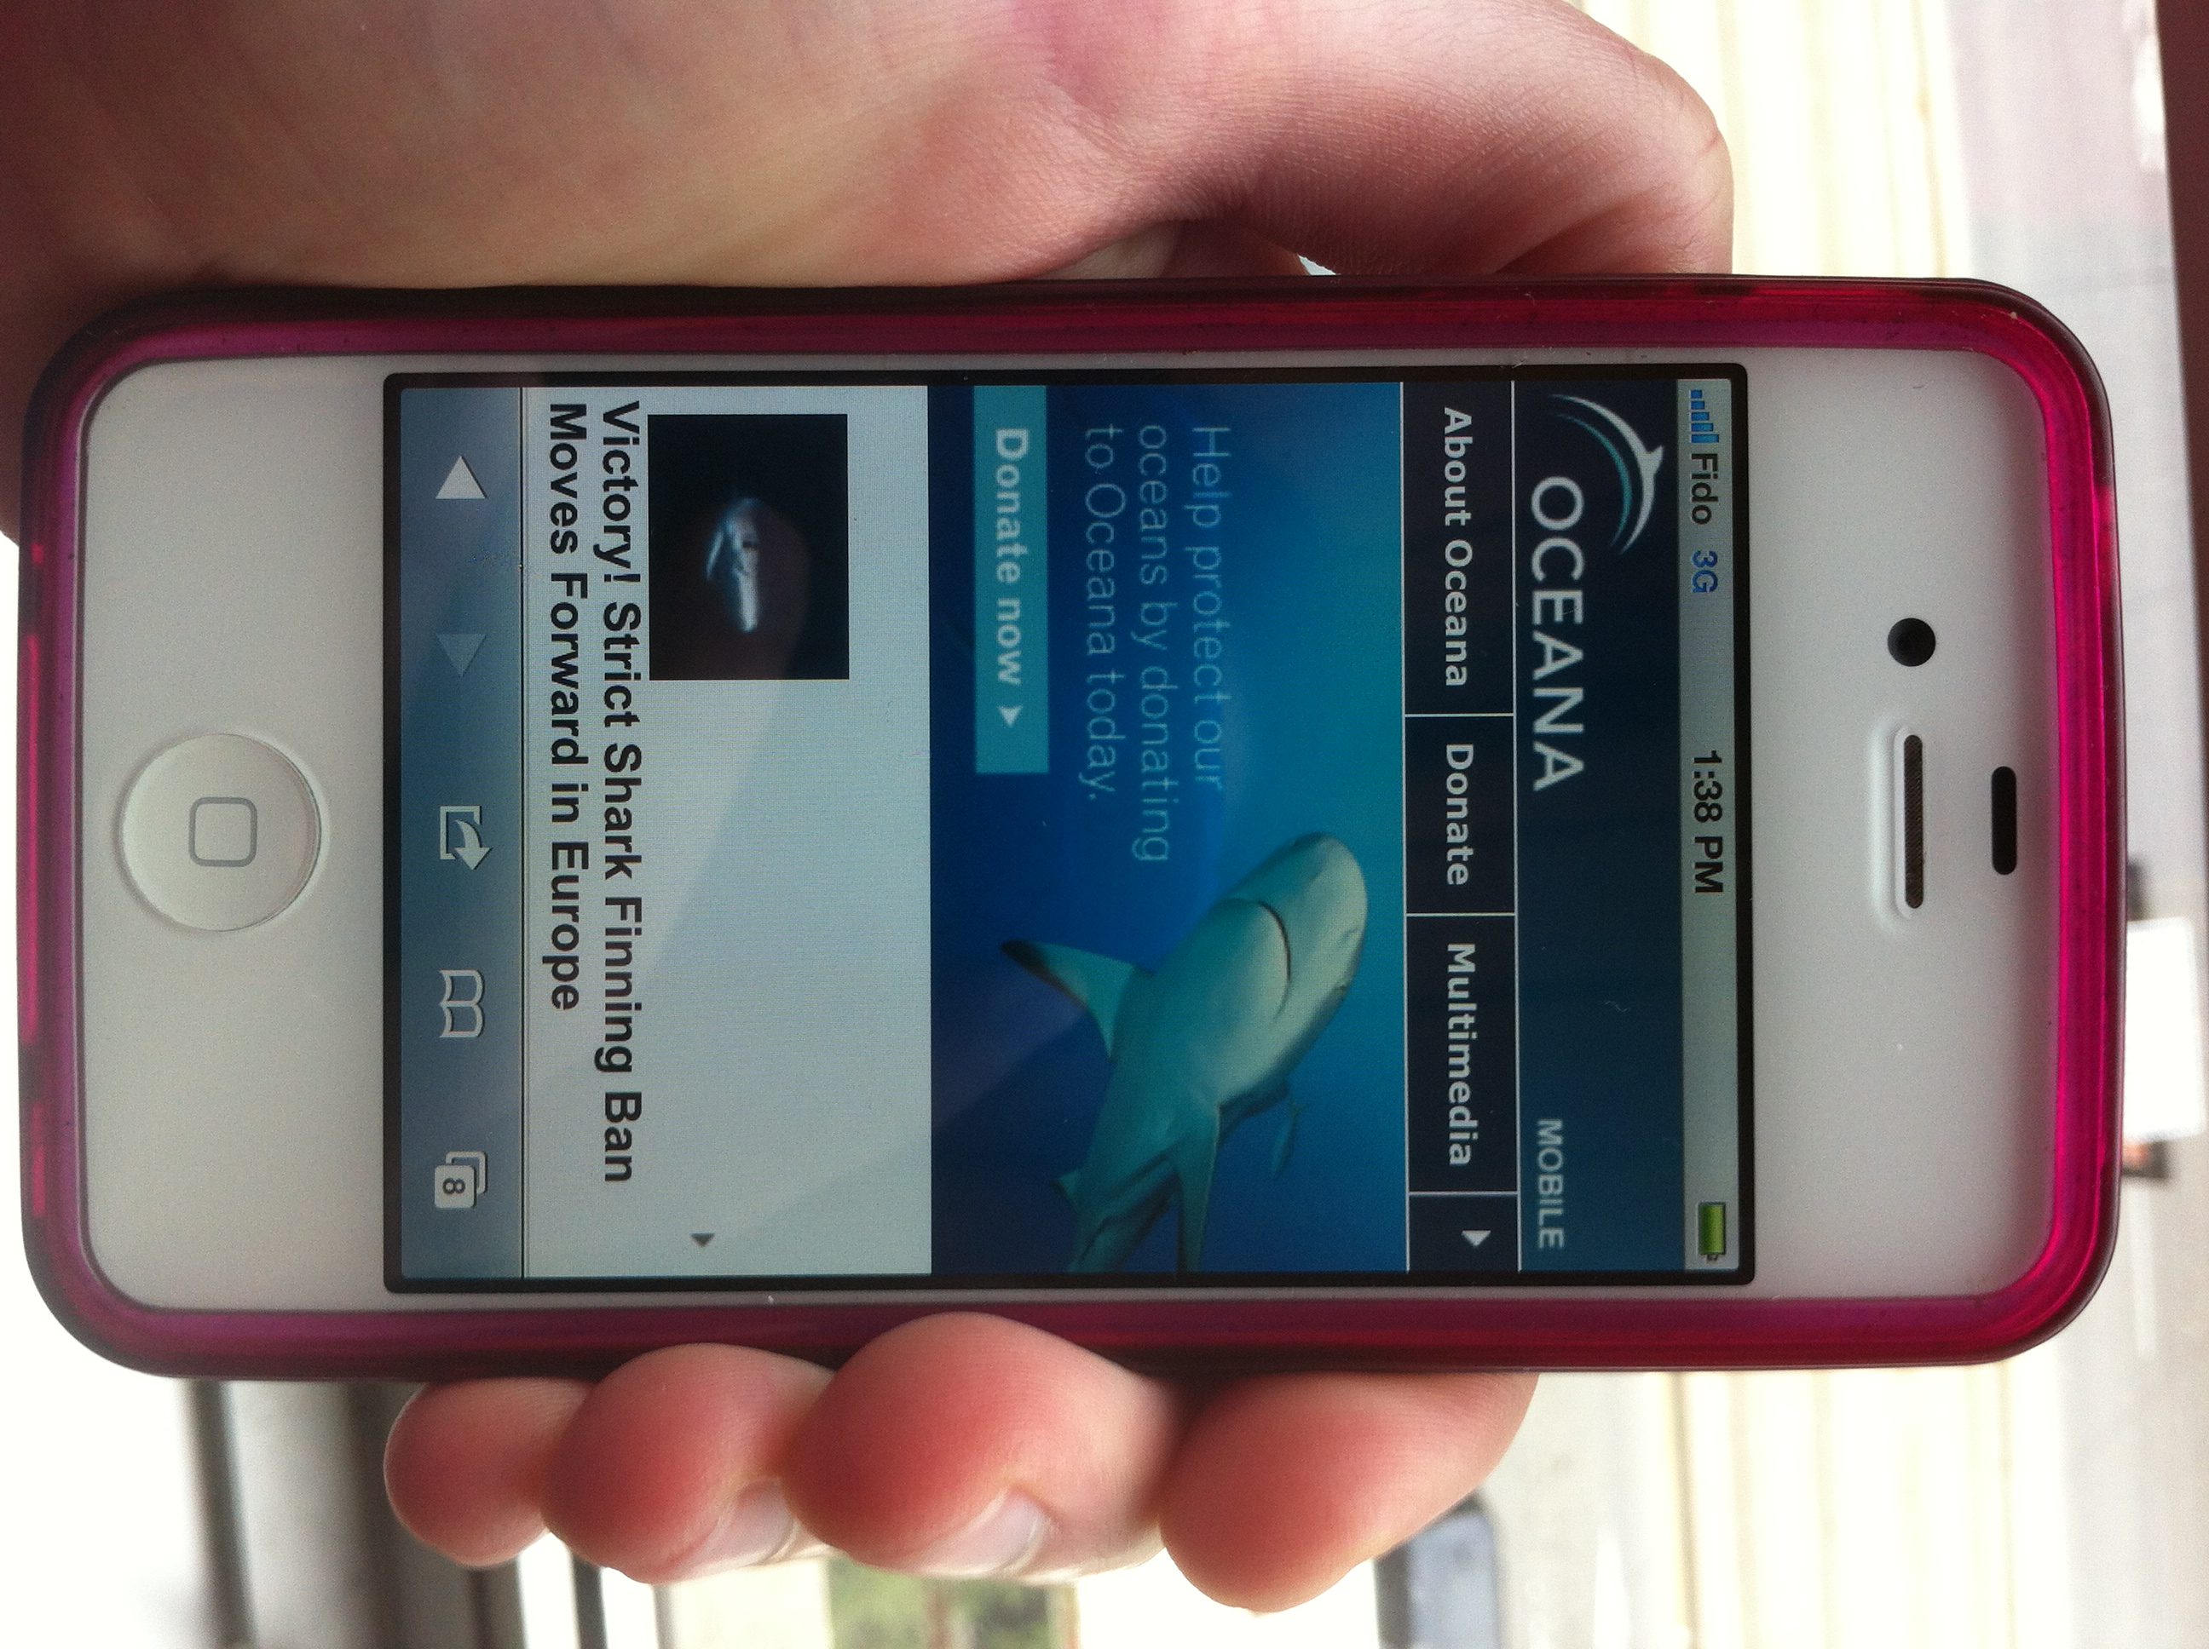
Mobile
Mobile-friendly websites, emails & content
  Best area to invest in
  Many of your other channels will be accessed via mobile
Text-to-donate (for charities)
Mobile apps
Mobile ads

Slide 22
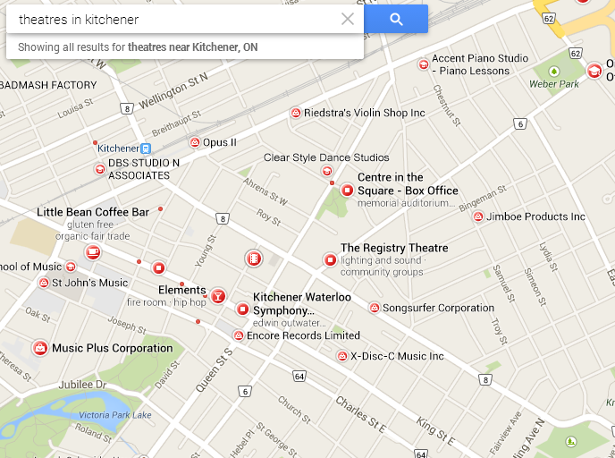
Other Online Channels
Location-based information
  Google Places
Online event listings
  Search “What to do in My Town this weekend”
Local bloggers

Slide 23
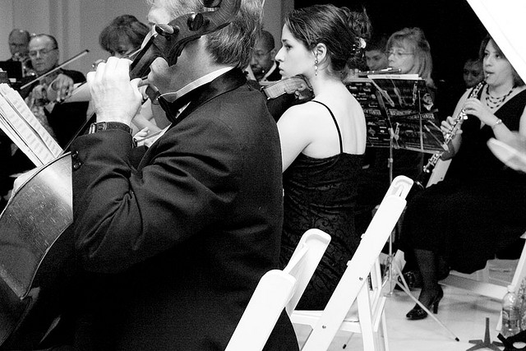
“Multi-Channel” Marketing
Your audience doesn’t just use one channel – so neither should you
Your channels should work together, complement each other, reinforce messages
You are the conductor!
  (And, often, the instrumentalists…)
Credit: http://www.flickr.com/photos/flickr-rickr/
Notes:
This is what you should aspire to. Don’t feel bad if you can’t completely pull it off.
Story about joining Cycle Toronto.

Slide 24
A Brief Review of Some
Marketing Basics

Slide 25
#1: Assess
What channels are you currently using?
  Both online and offline
How do you talk about yourselves?
  E.g. tagline, mission statement, elevator pitch, “About Us”
How would others describe you?
  Ask 2-3 audience members

Slide 26
#2: Define Goals & Objectives
Goals - what are you trying to get people to do?
Your main goals are likely:
  Engaging your current audience
  Reaching a new audience – broadening, deepening & diversifying
What are some specific objectives that you can set to help you get there?
  E.g. Increasing audience members < 45 years old

Slide 27

#3: Get to know your Target Audience
Create a “persona” for the type of person you want to reach
  How old are they?
  What are their lives like?
  Where do they live?
  What else do they do for fun?
  What social networks are they on?
  What value would they get from what you do?
Suzy Jones
Recommended worksheet: http://www.johnhaydon.com/2013/02/28/nonprofit-marketing-personas-workbook/

Slide 28
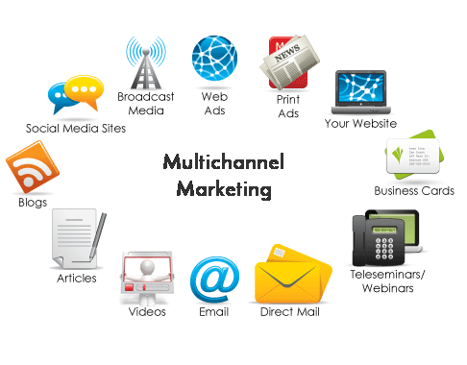
#4: Select your Channels
Be wise about choosing channels – only take on what you can maintain
It’s ok to experiment with new channels
  But don’t expect immediate results
Send similar messages on different channels that complement each other

Slide 29
#5: Craft your Message
“You marketing” vs “Me marketing”
  Focus on what matters to your audience, instead of talking about yourself
Share useful, interesting content
Strong calls to action
  Attend a performance
  Subscribe to our newsletter to hear about upcoming performances
  Follow us on Twitter to find out about more events in the community
  Share your thoughts on the performance on our Facebook page
  Volunteer at next year’s festival
Source: http://www.fundraising123.org/files/training/7%20Steps%20to%20Creating%20Your%20Best%20Nonprofit%20Marketing%20Plan%20Ever.pdf

Slide 30
#6: Define your Personality
If your organization were a person, what would it be like?
  Fun? Innovative? Creative? Friendly? Witty?
Show your personality in all interactions with audience members
  E.g. Website, social media, posters, box office, customer service
Tone may vary slightly depending on the channel
Recommended worksheet: http://nonprofitmarketingguide.com/docs/worksheets/NonprofitPersonalityVoiceStyleTone.pdf

Slide 31
The Nitty Gritty
Notes:
Now that you know all that… how are you going to put it in practice for your organization?

Slide 32
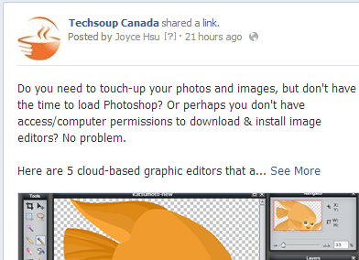
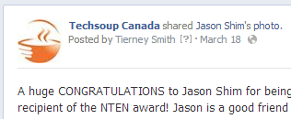
Build your team & assign roles
Marketing can be a team effort
If you have multiple people helping, make sure you are:
  Coordinated (see: content calendar)
  Consistent (see: define your personality + guidelines)

Slide 33
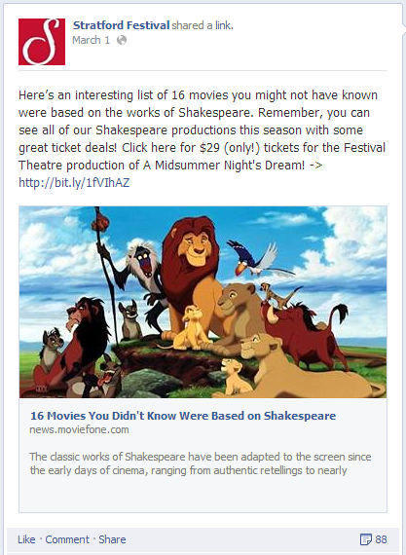
Share great content
Just a few examples...
  Upcoming performances
  Performance previews
  Behind-the-scenes insights
  Blog posts/news articles about the arts
  Other events going on in the community
Notes:
You’re lucky to be in an extremely content-rich sector

Slide 34
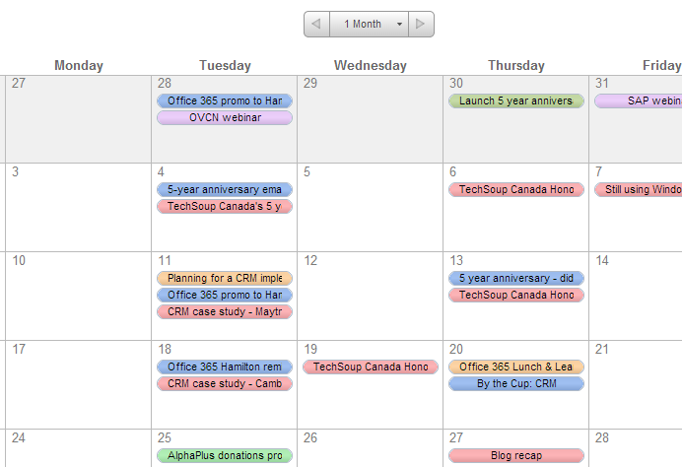
What do you want to share when?
Create a content calendar!
Plan the timing of the stages of your campaign
Share the calendar with all staff & volunteers
Recommended template(s): http://www.bethkanter.org/editorial-calendar-2013/

Slide 35
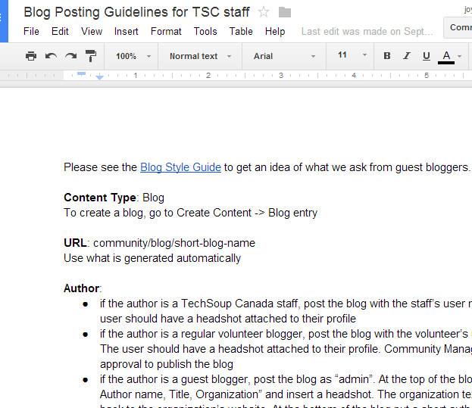
Guidelines & policies
Create consistency around how your organization behaves online
Find a balance between structure & trust
Recommended worksheet: http://www.idealware.org/reports/nonprofit-social-media-policy-workbook

Slide 36
Measure & Evaluate
Notes:
*** add speaking notes for this section for Joyce ***

Slide 37
Why measure?
You need to know if it’s working (or not!)
  Contribute to your org’s mission
  Experiment & learn
You need to prove to others that it’s working
  Leadership buy-in
  Funding

Slide 38
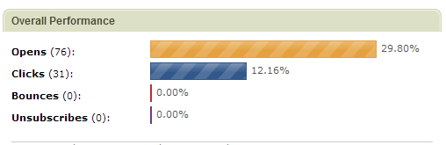
A few common metrics
Online ads
Views/reach
Click through rate
Social media
Views/reach
Engagement/comments
Shares
Website
Page views
Time spent on page
Email
Open rate
Click through rate

Slide 39
Keep your goal in mind
When possible, relate your metrics back to your original goals
  Conversions = how many people do the action you wanted
Challenges to be aware of
  Multiple channels contribute but only one creates the conversion
  Often impact is indirect (e.g. increased calls to box office after email blast)
Best practice is to set “Goals” using web analytics

Slide 40
Questions? Comments?
www.techsoupcanada.ca
@techsoupcanada
facebook.com/techsoupcanada

Slide 41
Register for the rest of the series!
Part 2: Tuesday, April 22nd:
  Digital marketing 101: What you need to know about websites
Part 3: Thursday, May 15th:
  Digital marketing 101: Being social with social media
https://ccio.on.ca/news/new-webinar-series-arts-presenters

Slide 42
More on “You” vs “Me” Marketing
You marketing: The kind of communication that centers on the organization. When I pick up your brochure as a prospect, I am learning about you. You are talking about you. You are telling your side of the story.
Me marketing: Most people are tuned into what matters to them. They care about messages that speak to their needs. If I pick up your brochure and it is talking about me, I am far more interested. This approach forces you to find the benefits of what you are offering to people.
Look at your website and brochures. Do you talk about your mission, your great staff, your awards, your programs? Is it all about you, you, you? How can you change the copy to reflect more "me marketing”?
Source: http://www.fundraising123.org/files/training/7%20Steps%20to%20Creating%20Your%20Best%20Nonprofit%20Marketing%20Plan%20Ever.pdf

