Slide 1
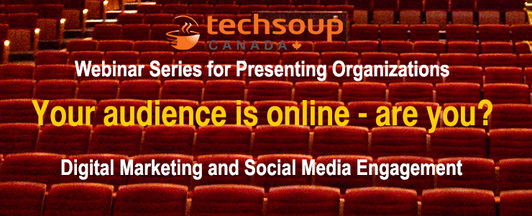

Slide 2


Webinar Series for Arts Presenters
Presented by:

Slide 3
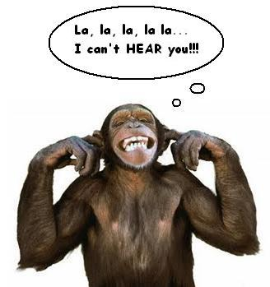
Reminder
You can hear us, but we can’t hear you!!

Slide 4

Webinar tips
Can’t hear?
  Try turning up your volume
  Call in or use headphones
Have a question? Use the Q&A box

Slide 5


Digital Marketing 101
Connecting in the inbox with email marketing
May 29, 2014
with

Slide 6
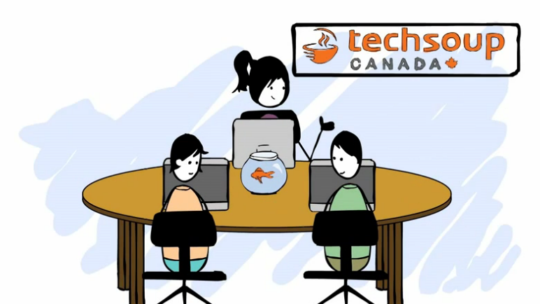
About TechSoup Canada
We help nonprofits use technology to achieve their full potential.
Register your organization today, to be eligible to request over 300 products from 25 donor partners!
www.TechSoupCanada.ca/getting_started

Slide 7
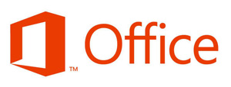



Technology Donations Program
You may be eligible to get donations of…
Is my org eligible?
Does your business number end in RR0001?
Do you have a Letters Patent from Industry Canada?
Are you incorporated as a not-for-profit corporation with your province?
Are you a library?

Slide 8
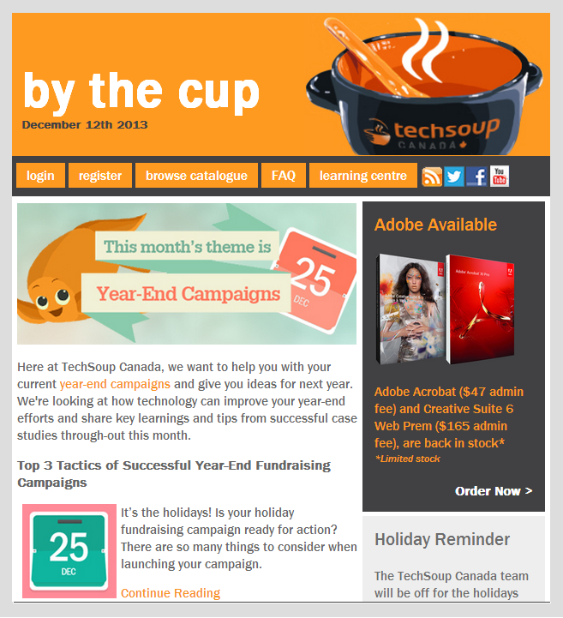
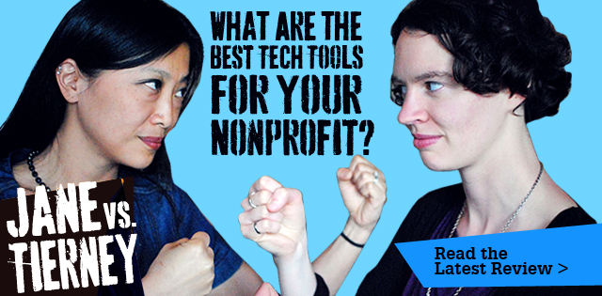



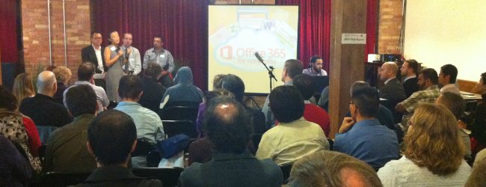
We create and curate tech resources
@techsoupcanada
facebook.com/
techsoupcanada
feeds.feedburner.com/
techsoupcanada

Slide 9
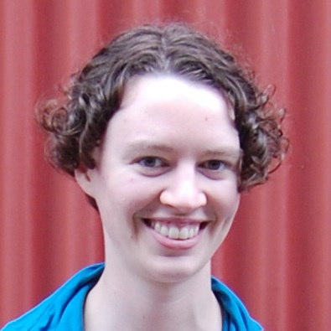
About Me
Tierney Smith
Program Manager at TechSoup Canada
@TierneyS

Slide 10
Agenda
Email marketing best practices
Email management systems
Taking it to the next level
Canadian Anti-Spam Legislation

Slide 11
Is email dead?
Notes:
No
Multi-channel!!!!

Slide 12
Email Marketing Best Practices

Slide 13
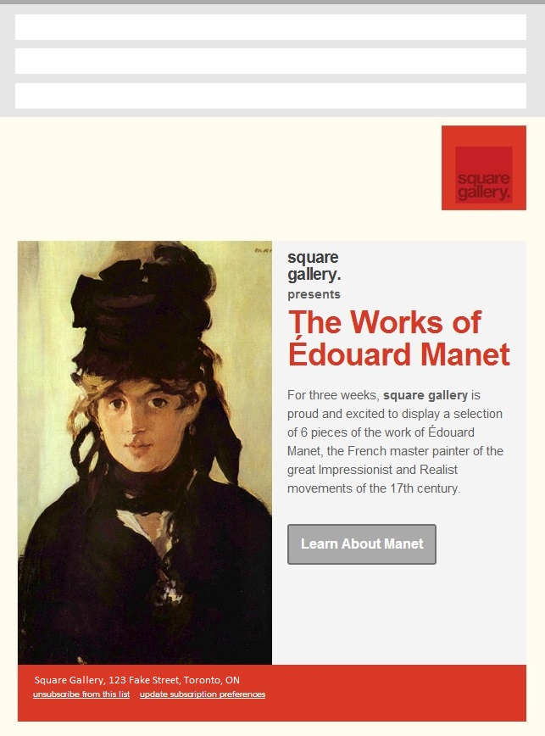
Anatomy of a Killer Email
1
To: John Doe, Art College
2
From: Susan Curator, Square Gallery
3
Subject: Experience the Works of Manet
4
Targeted recipient
Recognizable Sender (better if it’s from an actual person)
Clear and compelling subject line (under 50 characters)
Branded email
Valuable content
Clear call-to-action
Company info & unsubscribe links/email preference
5
6
7

Slide 14
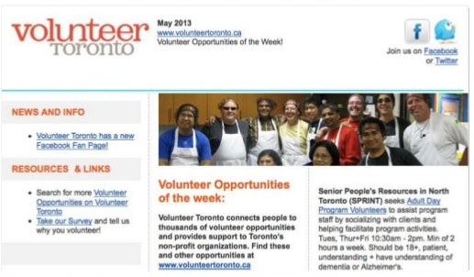
A Good Email Is …
… by, for and about people (not robots)
Keep it conversational
Read your email aloud to check tone/language
… based on what you know about the recipient
Segment your list based on language, how the email was acquired, previous action taken, etc.
Credit: Eric Squair
http://eric.squair.ca/2013/05/08/measuring-engaging-your-email-list/

Slide 15
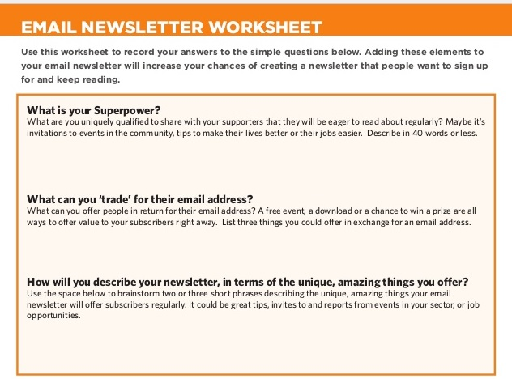
How to Get Sign-ups
Offer people something they value
Figure out what you can offer that will be of value to your readers
What is your superpower?
What can your organization offer that no one else can?
What can you tell people, teach people, connect people with that no one else can?
Credit: Eric Squair
http://eric.squair.ca/2013/05/08/measuring-engaging-your-email-list/

Slide 16
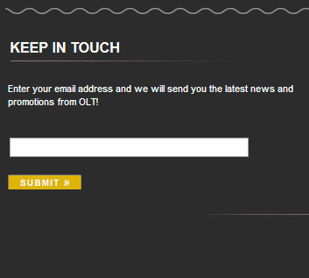
How to Get Sign-ups
Email signup forms
Simply asking people may not work – you need to sell them on it!
Establish credibility and trust (ie., mention email frequency), give them a sense of what they will be getting
Best to collect email, first name and postal code
Example from Ottawa Little Theatre:
Gives people a sense of they they’ll be getting
Brief newsletter description
Focused call-to-action
1
2
3
Credit: Eric Squair
http://eric.squair.ca/2013/05/08/measuring-engaging-your-email-list/

Slide 17
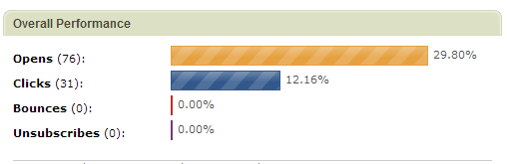
Do people read my emails?
# of people who open your email
Click Through
Rate =
# of people who click on a link
Open Rate =
# of people you sent it to
# of people you sent it to
# of emails that can’t be delivered
# of emails that can’t be delivered
Bounce Rate =
Unsubscribe Rate =
# of people you sent it to
# of people you sent it to

Slide 18
How do I get people to read my emails?
Subject Line
  Keep it short
  Share what’s inside
Relationship
  What value have you provided in the past?
  How engaged are you?
Also consider:
Time & day
  Weekday vs weekend?
  Early morning, lunch, after work, evening?
Volume of email
  How much email do you send?
List cleanup
  Get rid of old subscribers who aren’t engaged

Slide 19
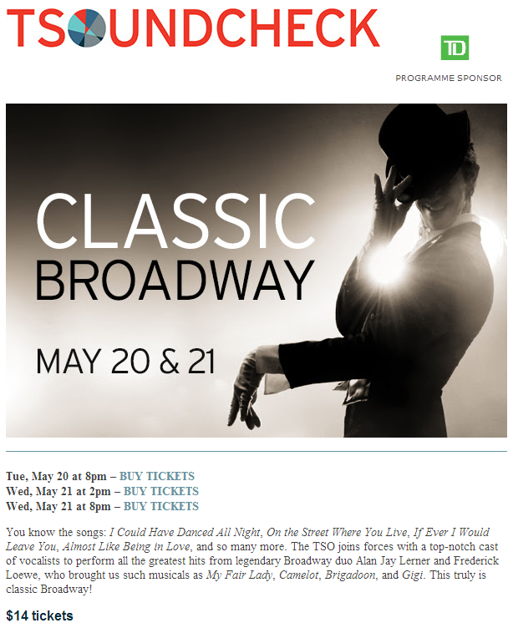
Doing well
  Compelling image
  Call to action – buy tickets
  Description draws you in, conversational tone
  Clear info – dates, price
Could be better
  Large image will be hidden for some
  Call to action button rather than links
  Layout/flow
  Could be more personal

Slide 20
What tips do you have for making emails engaging?

Slide 21
Email Marketing Systems

Slide 22
How do you send marketing emails?
Outlook, Gmail, etc (my personal/work email account)
Mailchimp
Constant Contact
Vertical Response
iContact
My organization’s ticketing system or database
Other
I don’t send marketing emails

Slide 23
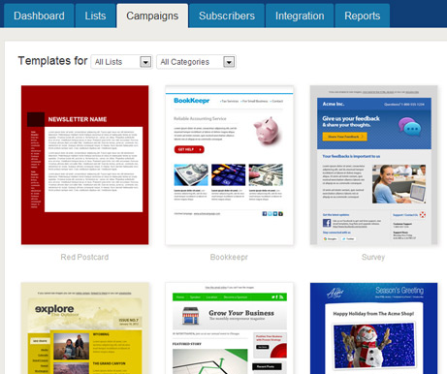
What’s an Email Marketing System?
Email marketing systems are web-based services that are designed to send mass emails:
Approved bulk mailers
Follow professional and legal mailing practices
Provides listing hosting and subscription management
User-friendly and typically requires little to no technical skill
Detailed reporting & feedback

Slide 24
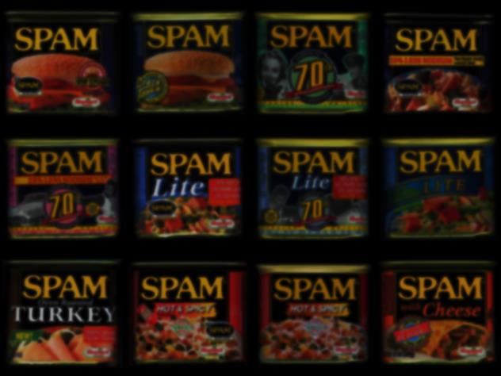
“But can’t I just use Outlook/Hotmail/Gmail?”
Your standard email account (e.g., Outlook, Gmail, Hotmail, Yahoo etc.) is not designed for email marketing
No authentication = easily get blacklisted or identified as spam
Can’t track clicks or opens
No automatic bounce removal
No control over unsubscribing
No personalization
Poor HTML
THIS IS YOUR NEWSLETTER
SENT VIA
OUTLOOK

Slide 25



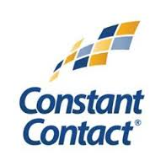
Choosing an Email Management System
Factors to Consider:
Ease of use
Availability of templates / ability to create your own templates
Pricing (Per email? Per subscriber?)
Ability to segment your lists
Further reading: https://www.techsoupcanada.ca/community/blog/jane-vs-tierney/challenge-1-newsletters

Slide 26
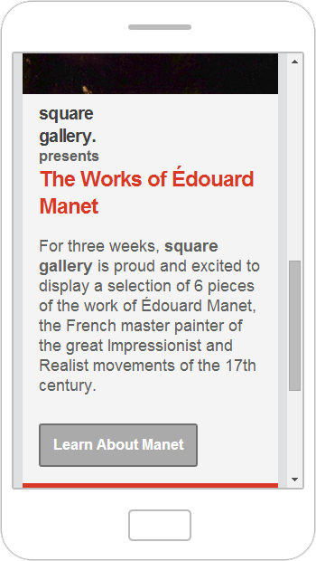
Optimize Your Emails for Mobile
48% of emails are opened on mobile devices (smartphone & tablet)
If your email doesn’t look good, it will likely get deleted or ignored
Use a pre-built responsive template or make your template responsive
  Requires CSS skills
Source: Litmus
https://litmus.com/blog/48-of-emails-are-opened-on-mobile-gmail-opens-down-20-since-tabs
Resources:
http://www.campaignmonitor.com/guides/mobile/design/
http://www.emailonacid.com/blog/details/C13/a_responsive_design_tutorial

Slide 27
Take it to the next level

Slide 28
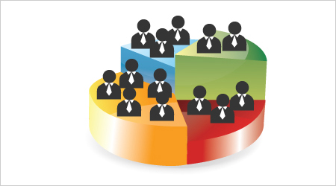
List Segmentation
Consider what information you have about your subscribers
  Location (postal code)
  Past performances attended
  Past behaviour (opened/clicked previous emails)
Segment your list based on the information
Customize your email for each segment

Slide 29
Track website visits
Name the campaign and segment
Create “URL Builder” links for each combination of campaign/segment
  https://support.google.com/analytics/answer/1033867?hl=en
Use “URL Builder” links for all links to your website in the email
  Note: some email management systems do this automatically!
Check Google Analytics to see how many visits came from each campaign
http://www.techsoupcanada.ca/Microsoft/windows-8-is-here?utm_source=customer_service&utm_medium=email&utm_campaign=email_signature

Slide 30
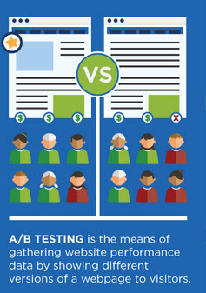
A/B Testing
Decide which to test & create 2 options
  Subject line
  “From” name
  Email content – design, call to action, text
Send each option to a small portion of your list
  5-15%
See which is more successful & send to the rest of your list!
Resources:
http://wiredimpact.com/blog/test-nonprofit-newsletter/
http://www.slideshare.net/charityexpress/prove-it-ab-testing-for-nonprofits

Slide 31
Canadian Anti-Spam Legislation

Slide 32
Types of communications included
Emails, text messages, messages on social media
With topics such as:
  Selling tickets to an event / performance
  Promoting services
  Asking for donations
  E-newsletters
  Promoting your organization

Slide 33
Get consent!
2 types of consent:
  Express consent: person has given written or oral consent to get specific types of messages
  Implied consent: person has used your services in the last 2 years
    Attended a performance, made a donation, volunteered
Always include:
  Who is sending the message
  How to contact you (address, phone #, email)
  A way to unsubscribe
Some nuances & exceptions to be aware of
Resource: http://www.slideshare.net/techsoupcanada/cas-lmaanitzemel2014-0527

Slide 34
What is one next step you plan on taking after this webinar?

Slide 35
Questions? Comments?
www.techsoupcanada.ca
@techsoupcanada
facebook.com/techsoupcanada

