Slide 1
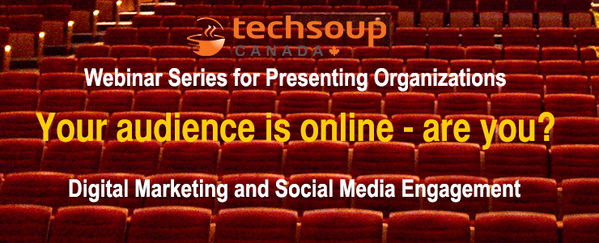

Slide 2


Webinar Series for Arts Presenters
Part 4: Thursday, May 29th:
  Digital marketing 101: Connecting in the inbox with email marketing
Presented by:

Slide 3
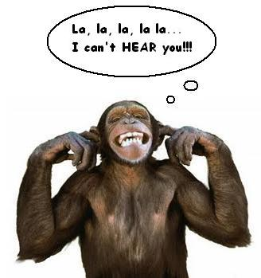
Reminder
You can hear us, but we can’t hear you!!

Slide 4

Webinar tips
Can’t hear?
  Try turning up your volume
  Call in or use headphones
Have a question? Use the Q&A box

Slide 5


Digital Marketing 101
Being social with social media
May 15, 2014
with

Slide 6
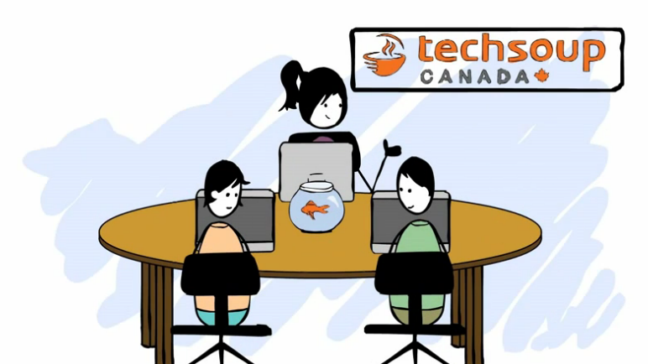
About TechSoup Canada
We help nonprofits use technology to achieve their full potential.
Register your organization today, to be eligible to request over 300 products from 25 donor partners!
www.TechSoupCanada.ca/getting_started

Slide 7





Technology Donations Program
You may be eligible to get donations of…
Is my org eligible?
Does your business number end in RR0001?
Do you have a Letters Patent from Industry Canada?
Are you incorporated as a not-for-profit corporation with your province?
Are you a library?

Slide 8
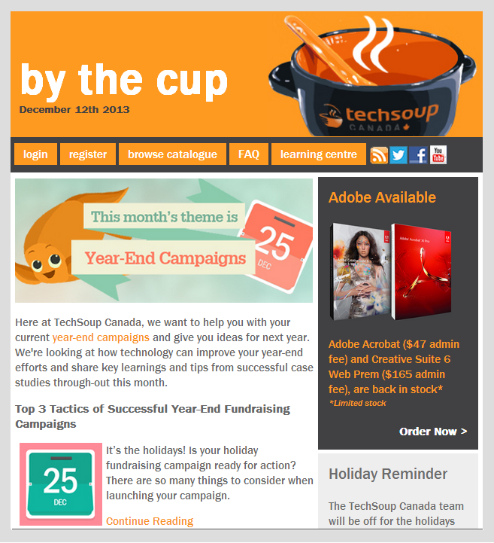
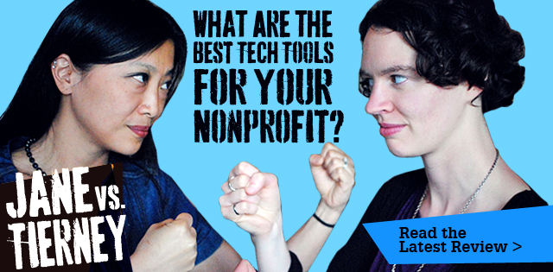



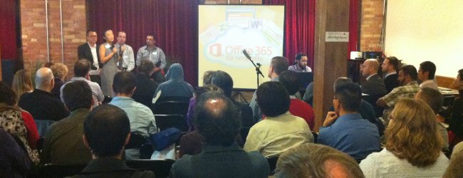
We create and curate tech resources
@techsoupcanada
facebook.com/
techsoupcanada
feeds.feedburner.com/
techsoupcanada

Slide 9
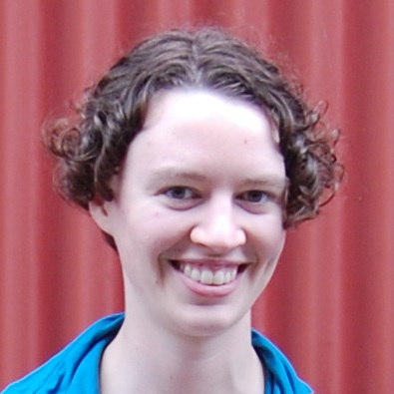
About Me
Tierney Smith
Program Manager at TechSoup Canada
@TierneyS

Slide 10
Agenda
Understanding social media
Selecting a channel
Using social media
Measurement & evaluation
Social media examples
Q&A

Slide 11
Understanding Social Media
Notes:
*** add speaking notes for this section for Joyce ***

Slide 12
What are your goal(s) for social media?

Slide 13
Why is Social Media important?
55%
48%
39%
of Canadians (interested in arts & culture) use social media to connect with art organizations
increased interest to attend an arts event through posts on social media
attended an arts or cultural event due to posts on social media
Social Media Plays a Major Role in Exposing New Audiences to Canadian Arts Organizations
http://corporate.askingcanadians.com/social-media-plays-a-major-role-in-exposing-new-audiences-to-canadian-arts-organizations/
Notes:
People who like the arts like it all the time, not just a couple of times a year when they attend a performance! This is a way for them to stay connected to that side of themselves on an ongoing basis.

Slide 14
Before you adopt, understand the tool
Common stages of social media adoption:
Peer pressure. “Everyone’s doing it, let’s do it too!”
Underestimating work. “Social media is easy. My nephew can do it. Set up a Facebook account and start tweeting!”
Overestimating results. “We have some fans and followers, but we haven’t gained new donors, members, volunteers, etc.– what gives?”
Disappointment. “This social media thing is a bust. It takes too much time and the return isn’t worth it.”
Credit: Fenton
http://www.fenton.com/resources/see-say-feel-do/
Notes:
Social media complements other channels like your website and email, but doesn’t replace them.

Slide 15


Social Media is …
… Not a broadcast tool
It’s more like a conversation
Notes:
Not just about promoting your shows! View this as a tool for building relationships. People will be more exposed to you over time and then more likely to buy tickets (though they may not see themselves as having done so *because* of social media)

Slide 16


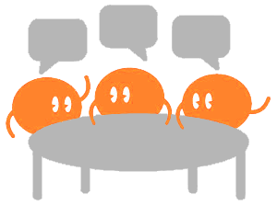

Social Media can be a lot of things
Think of Social Media as:
Community bulletin board
Email
Discussion board/public forum
A guided museum tour
A form/online form

Slide 17
Examples
Community bulletin board. Info about performances
Email. Answering questions about performances; building relationships with artists, other arts groups.
Discussion board/public forum. Post-show discussions and engagement.
A guided museum tour. Interesting/funny/thought-provoking arts content, news, videos, etc.
A form/online form. Mini-surveys on what artist/performance type you’d like to see next season.

Slide 18
Quick Reminders
Assess. Online “listening” – who’s talking about you; the arts?
Set Goals. What tangible outcomes do you hope to see?
Target Audience. Who in your audience (or potential audience) is using social media?
Define your voice. What is your organization’s personality?
Build your Team. Who’s in charge of strategy & direction? Who will be handling the day-to-day tasks (tweeting, posting, pinning, etc.)?

Slide 19
Selecting Social Media Channels

Slide 20
What social media channels do you have a presence on?
Facebook
Twitter
LinkedIn
Tumblr
Pinterest
Other

Slide 21
Understand Your Channels & Tools
Decide what channels to use and set goals
Facebook
Twitter
LinkedIn, etc.
More channels = more time & resources
Plan for 2 hours / week / channel
Notes:
Add more to this bit
Each channel is its own culture – it takes time to learn the language/ettiquette, meet the locals, etc. Don’t expect to barge in and find instant success

Slide 22

Who’s using social media?
68%
93%
of Canadians use social media
of social media users are on Facebook!
2013 Canada Digital Future in Focus - comScore, Inc
http://theexchangenetwork.ca/upload/docs/Canada's%20Digital%20Future%20in%20Focus%202013.pdf

Slide 23



With Facebook in the lead …
20%
18%
18%
10%
of social media users are on Twitter
of social media users are on LinkedIn
of social media users are on Tumblr
of social media users are on Pinterest

Slide 24
Who’s online*?
Age 18-29
Age 30-49
Age 50-64
Age 65+
The Demographics of Social Media Users – 2012
http://www.pewinternet.org/files/old-media/Files/Reports/2013/PIP_SocialMediaUsers.pdf
*out of total % of internet users in US

Slide 25

Guidelines &
Best Practices
Facebook
Ideal posts are 40 – 80 characters
Post photos over links (& use optimal sizes)
Individuals: Weekends, 12-7pm
Organizations: Weekdays, 1-4pm
2
Profile picture easily recognizable by potential fans
Engaging cover photo
Short & sweet bio with links
Optimize your profile picture/cover photo with links or more information
Customize your app thumbnails
4
1
5
3
Notes:
Mention FB challenges – resource at the end

Slide 26
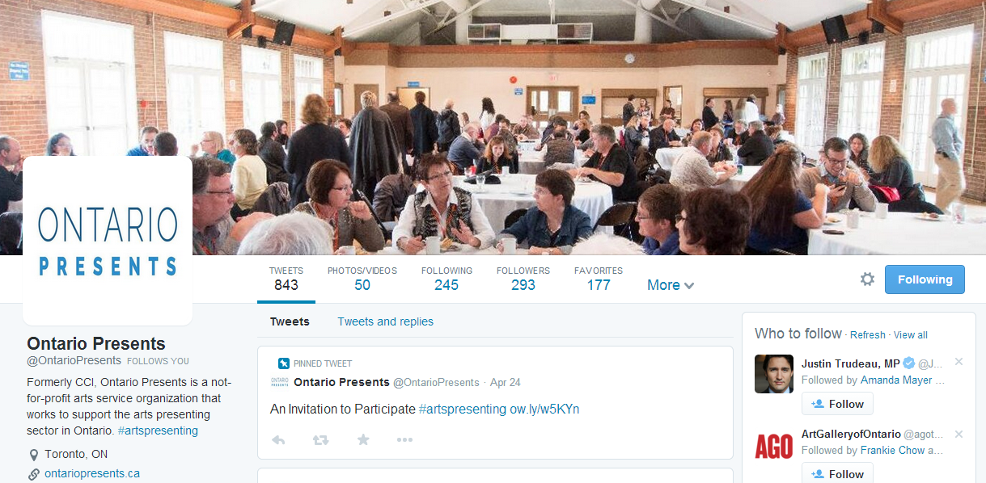
Guidelines &
Best Practices
Twitter
Ideal tweets are 100 characters
Max. two #hashtags
Individuals: Midweek & weekends, noon & 6pm
Organizations: Weekdays, 1-3pm
Recognizable profile picture
Branded Twitter handle
>160 character bio with URL & #hashtag to increase search ability
Pinned tweet
Visual & engaging cover photo
5
1
2
4
3

Slide 27
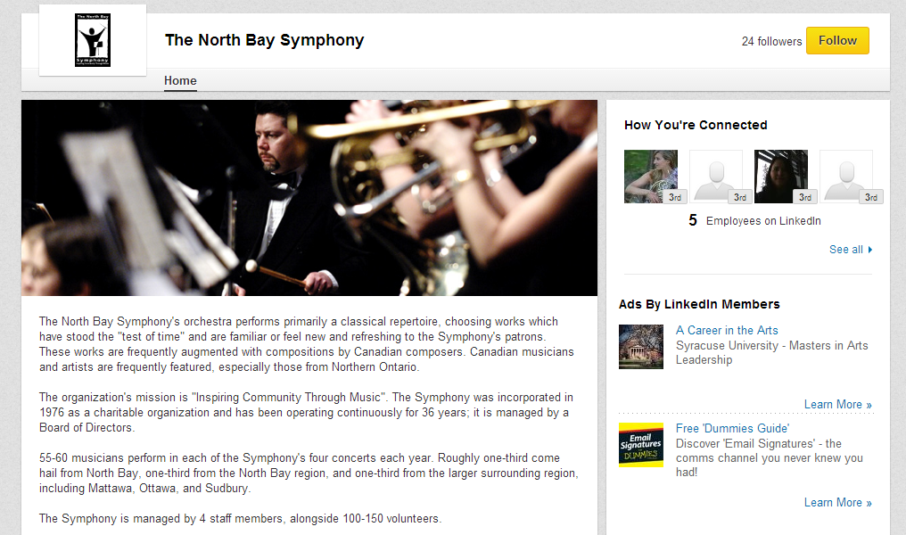
Guidelines &
Best Practices
LinkedIn
Engage in groups (& be genuine!)
Post jobs & events to increase your SEO
Share valuable content (including offers)
Tuesday-Thursday, 7-9am & 5-6pm
1
Recognizable profile picture
Include a cover photo
Short & sweet bio with links
Have every employee, board member or volunteer on LinkedIn reference you – increase your reach
4
2
3

Slide 28

Guidelines &
Best Practices
Tumblr
Follow other blogs & like/reblog
Keep posts short – one image/video/text update
Use #hashtags to increase reach
7-10pm
1
3
Choose a good, simple theme
Short & sweet bio with links
Know your post types (text, photo, quote, link, chat, audio & video) and keep it visually appealing
2
Notes:
Tumblr – one of the best ways to reach younger generations (it incorporate pretty much all elements of other social media tools). Very informal, fun and creative.
Tumblr is not for press releases, not well-suited for corporate/business style marketing
- A good example of this is Denny’s Diner (http://blog.dennys.com/)

Slide 29
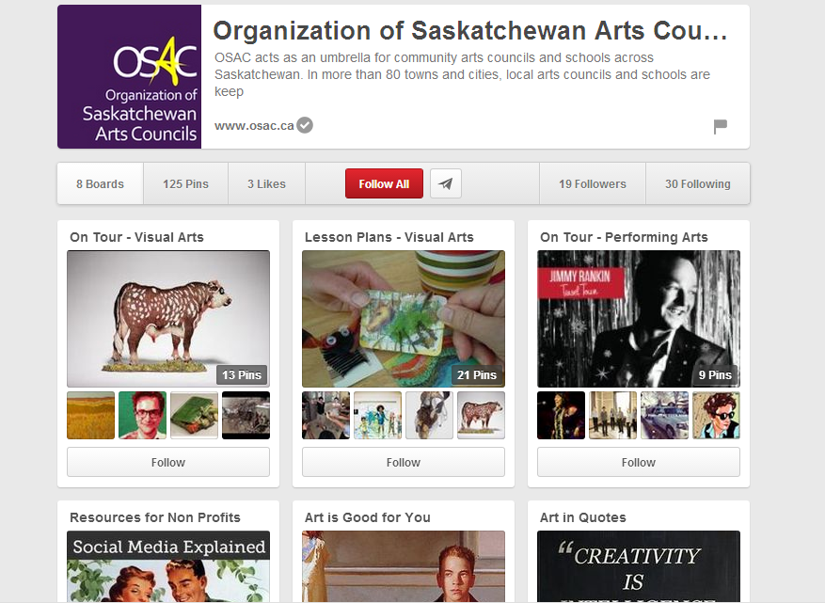
Guidelines &
Best Practices
Pinterest
Pin good photos/images
Add quality descriptions & use #hashtags
Repin & follow other like-minded people
Weekends, 2-4pm & 8pm-1am
1
Easily recognizable profile picture
Short & sweet bio with links
Start with 5-10 pinboards with specific categories with min. 5 pins for each board
2
3

Slide 30
Using Social Media
Notes:
See about how much to talk about this section.
-> Take the angle of “how to get great results on social media without it taking over your life”
Link to IW’s social media booklet

Slide 31

How to get followers & engagement?
Content Marketing
It’s not all about you – keep your own content and services to a minimum
Participate in discussions and dialogues
Be timely with your responses
Focus on stories and engaging your supporters
YOUR CAUSE
IS NOT
YOUR STORY.
tip!
Lack time? Focus on one channel and deliver consistent content – be the go-to resource!
Also, it’s not just about getting followers – think about your goal
Notes:
Promote others – e.g. Nicole promoting other businesses and festivals in Almonte. Idea of **reciprocity**

Slide 32
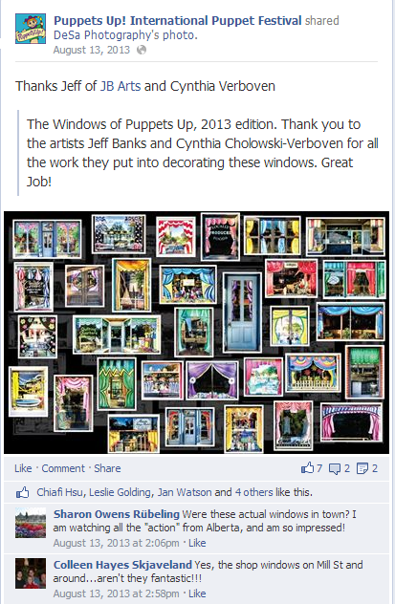

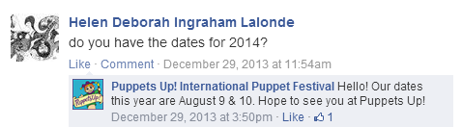
Puppets Up!
Examples

Slide 33
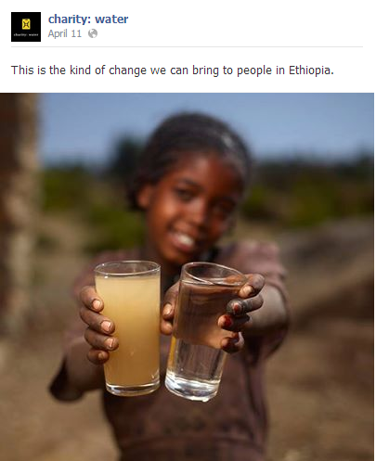
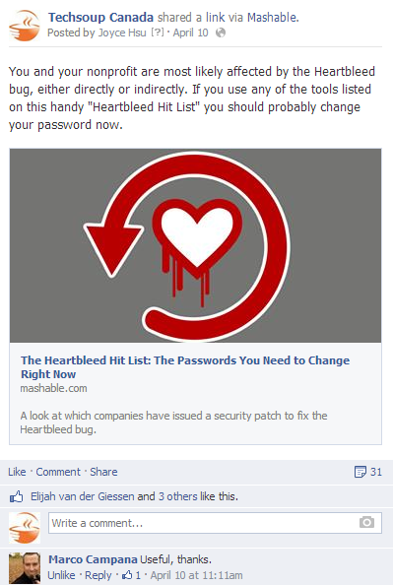
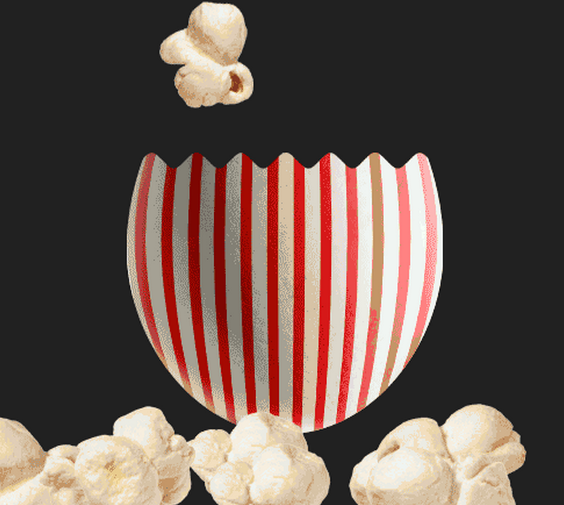
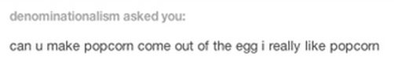
If you were a fan of your own organization, what would it take to engage you?
Something inspiring?
charity:water Facebook
Something fun?
Denny’s Diner Tumblr
Something useful?
TechSoup Canada, Twitter
Notes:
As an arts org you have a lot of great content at your fingertips. E.g. behind the scenes.

Slide 34
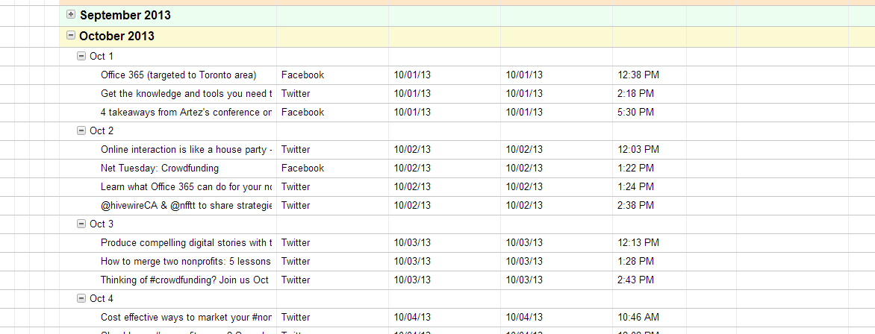
How often are you going to post, tweet, pin, etc.?
Notes:
When you’re starting out, plan some stuff to make it less overwhelming, but also be spontaneous and responsive.
As you get more comfortable with the channel, you won’t need to plan as much.

Slide 35
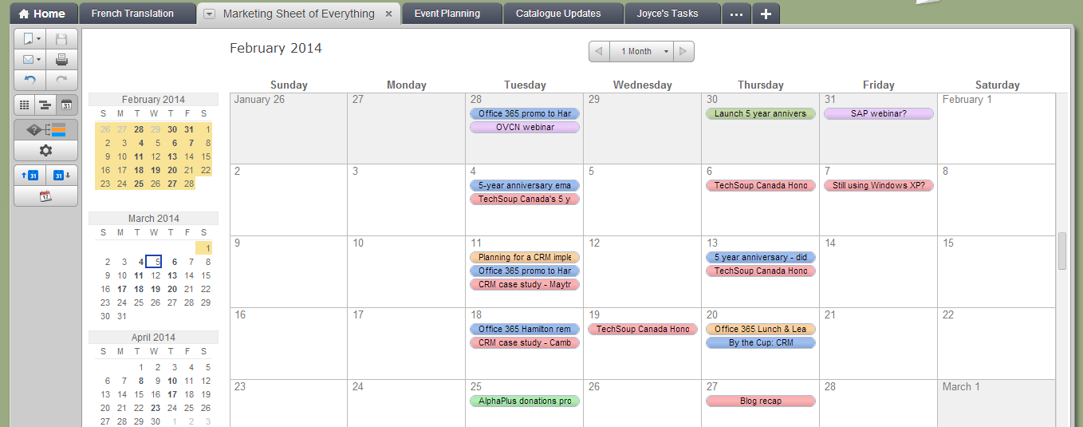
What content do you want to share and when?

Slide 36
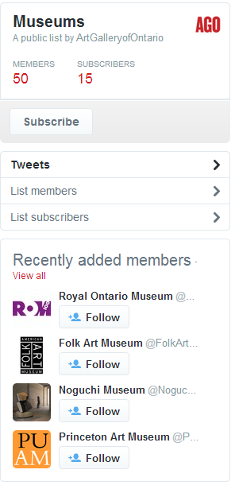
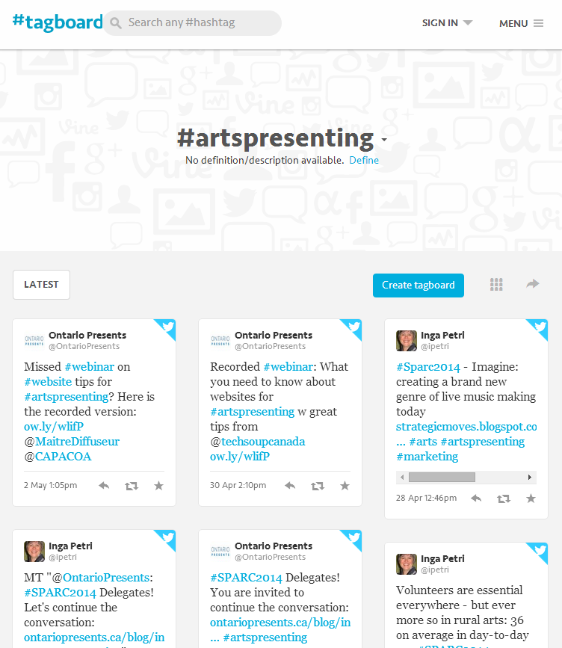
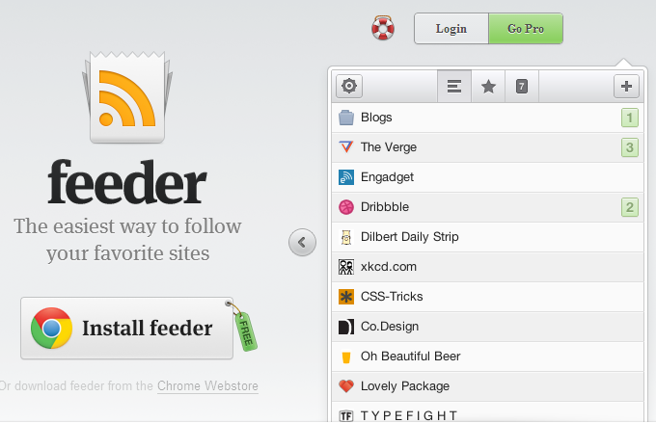
Ideas for creating and curating content
Use RSS feeders, follow Twitter lists and hashtags

Slide 37
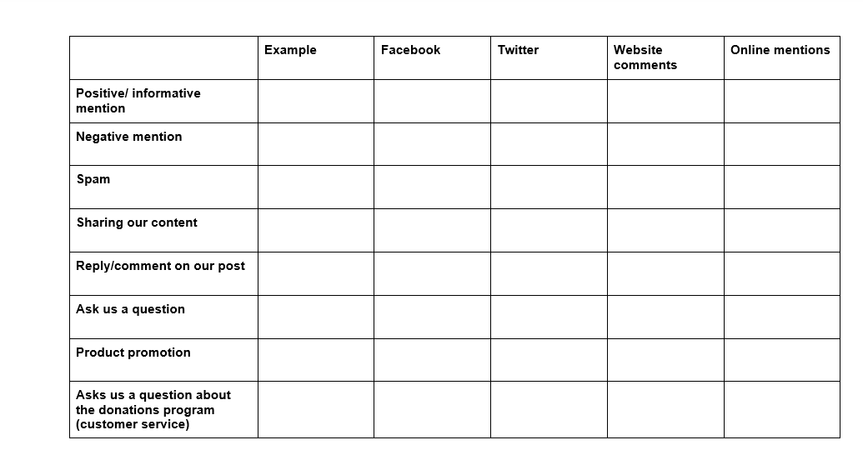
How do you respond and interact with your community?

Slide 38
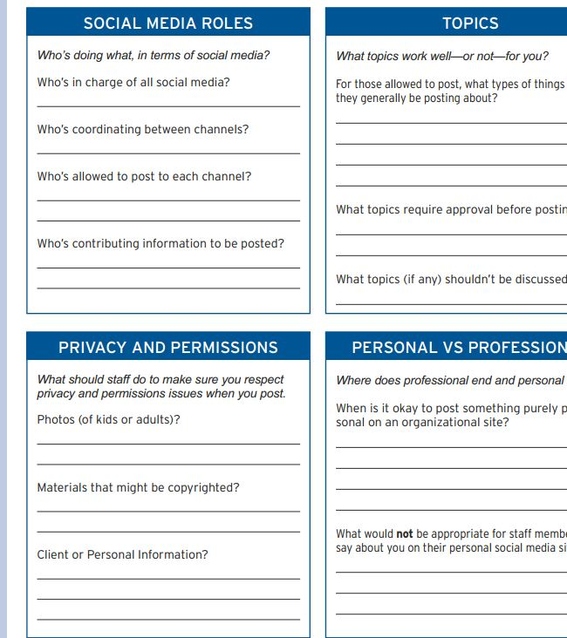
Articulate what is acceptable with a social media policy
Resource: http://www.idealware.org/reports/nonprofit-social-media-policy-workbook

Slide 39
Share one idea for content you could post on social media.

Slide 40
Measure & Evaluate Social Media
Notes:
*** add speaking notes for this section for Joyce ***

Slide 41
Why measure?
You need to know if it’s working (or not!)
  Contribute to your org’s mission
  Experiment & learn
You need to prove to others that it’s working
  Leadership buy-in
  Funding

Slide 42
How do you measure success?
Exposure Engagement Conversion
SAY
SEE
DO
FEEL
Credit: Fenton
http://www.fenton.com/resources/see-say-feel-do/

Slide 43
Example Metrics
SEE
FB page likes & reach
TW followers
RSS or email subscriptions
Youtube views
Bit.ly clicks
SAY
FB post likes & shares
Retweets
Email forwards
Repins & board followers
FEEL
FB shares with message
Retweet with message
Comments
Online mentions
DO
Donations
Advocacy actions
Event attendance
Membership
Volunteerism
Credit: Fenton
http://www.fenton.com/resources/see-say-feel-do/
Notes:
Keep in mind not everything can be directly tracked. E.g. in the fundraising world, social media has proved bad for getting donations but great for keeping donors engaged in what is going on

Slide 44
Facts about measurement tools
Some tools are really expensive. Also they can overwhelm you with data
There are lots of free & low cost tools. Use them only if they measure the metrics you want
At the end of the day, it all comes back to your spreadsheet

Slide 45
Let’s put this into practice
Notes:
Nicole’s case study?

Slide 46
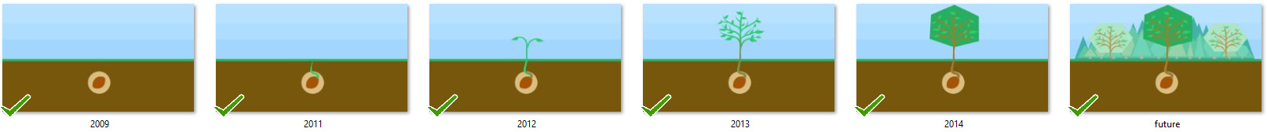
TechSoup Canada’s 5 Year Anniversary
Celebrate positive impact
Share our history
Engage members
Had an initial idea of a web-based timeline

Slide 47
Benchmark
TechSoup Germany celebrated their anniversary recently:
Made a website
Held a contest
4 stories shared online

Slide 48
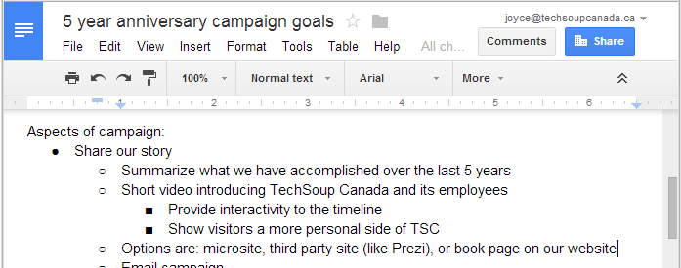
Goals: Encourage members to share stories (benchmark at 4), Member appreciation (aim for three posts), Tell a Friend (email campaign)

Slide 49
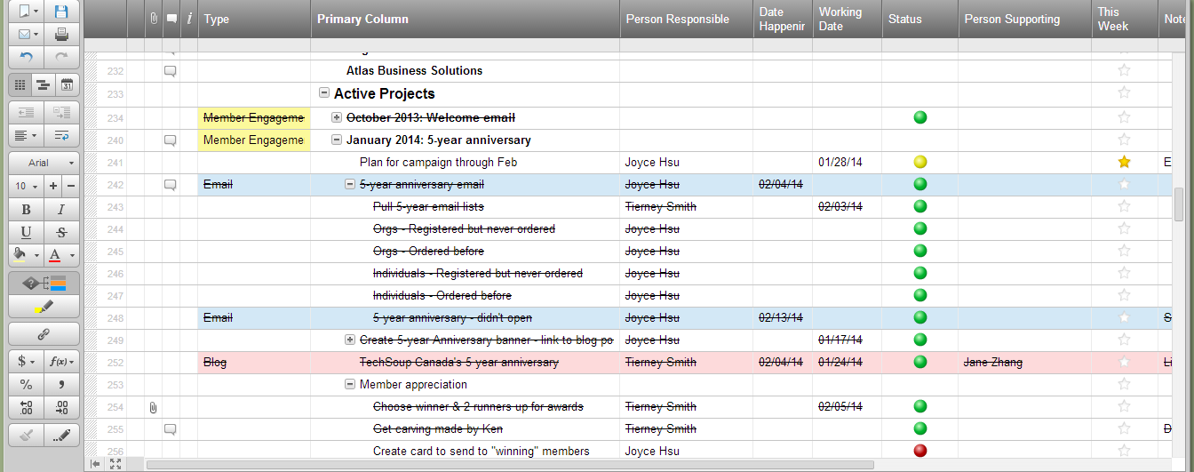
Scheduling campaign activities & assigning roles

Slide 50

Campaign marketing & promotion

Slide 51
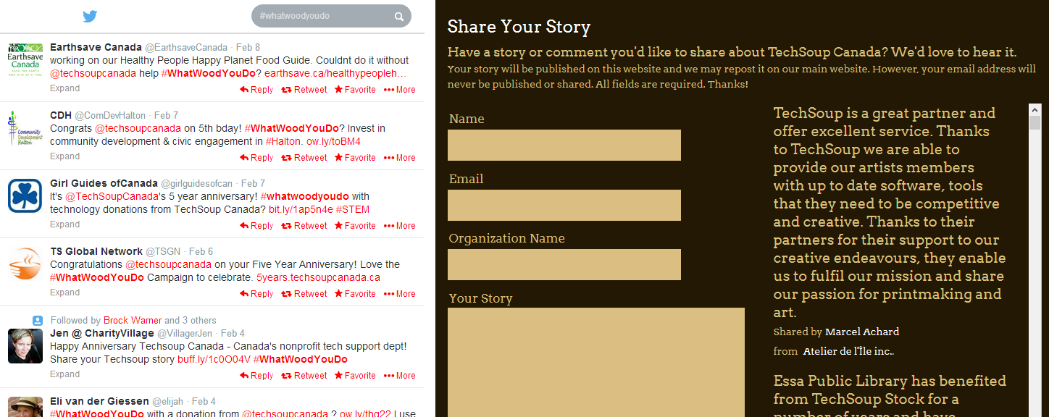
Encourage engagement with Twitter #WhatWoodYouDo
Easy for members to share stories on microsite

Slide 52
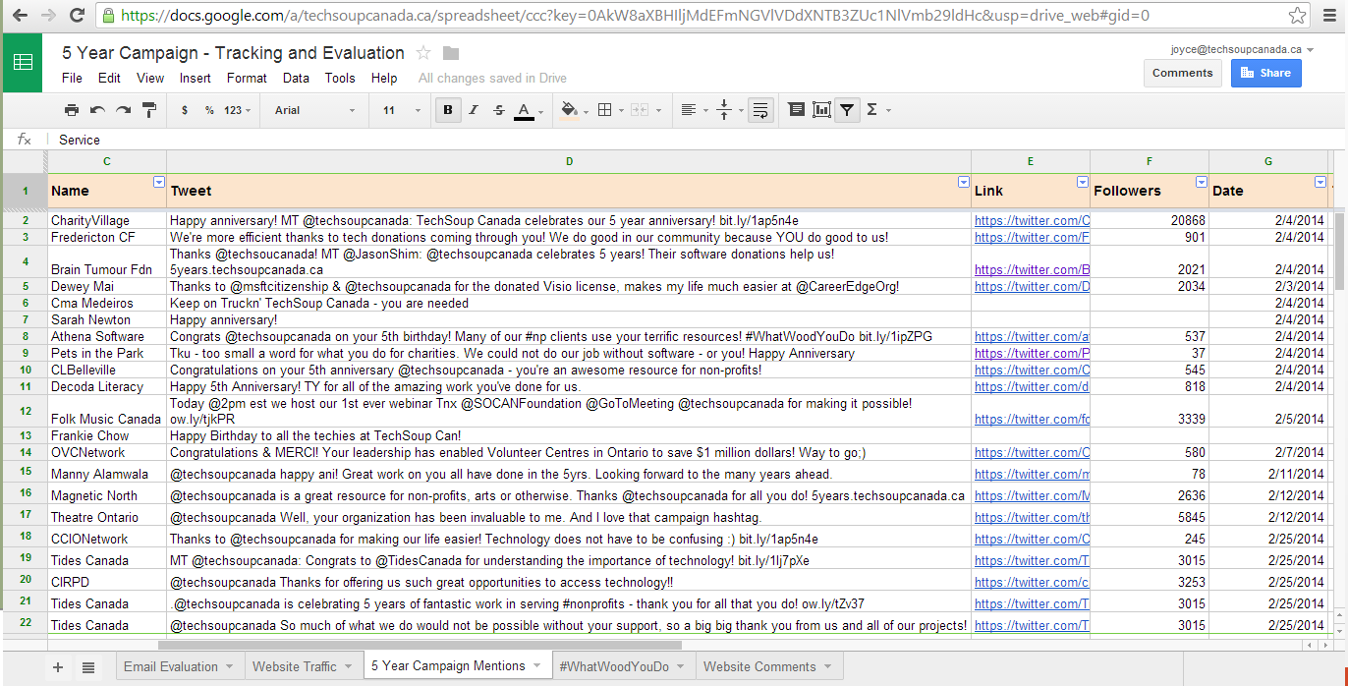
Dashboards to measure & evaluate

Slide 53
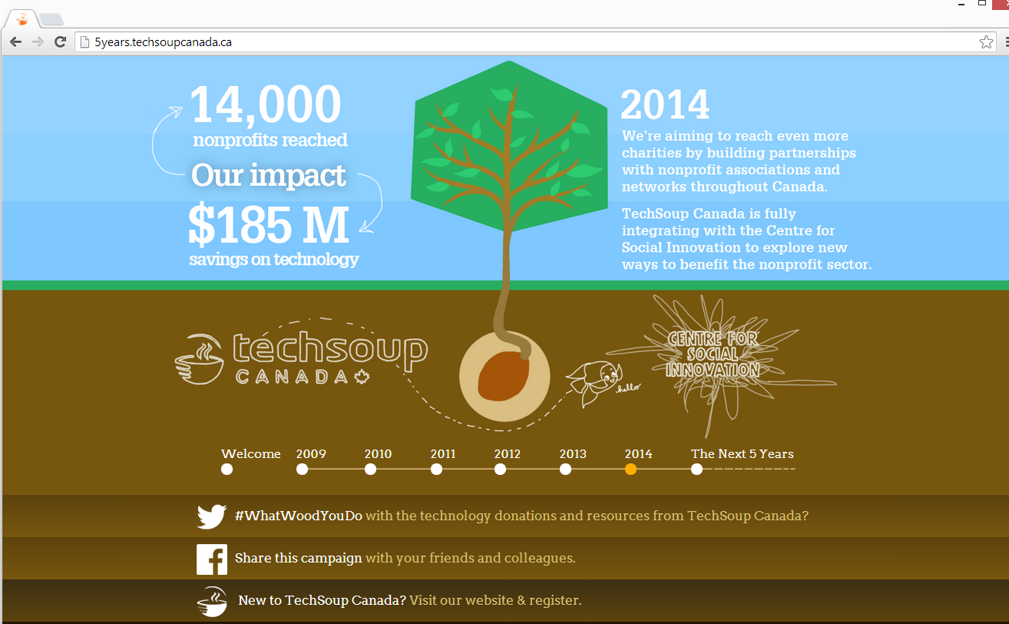
TechSoup Canada’s
5 Year Anniversary Campaign Results
1 month campaign:
520 visits/mth
51 tweets/posts
18 member stories
Engagement lasted throughout the month
… campaign success!

Slide 54
Questions? Comments?
www.techsoupcanada.ca
@techsoupcanada
facebook.com/techsoupcanada

Slide 55
Resources
Tips for succeeding on Facebook
  http://blog.bufferapp.com/facebook-reach-strategies
Ideas for social media engagement
  http://www.bethkanter.org/squirrel-kiss
Idealware’s Nonprofit Social Media Decision Guide
  http://idealware.org/reports/nonprofit-social-media-decision-guide
Idealware’s Nonprofit Social Media Policy Workbook
  http://www.idealware.org/reports/nonprofit-social-media-policy-workbook

Slide 56
What is one next step you plan on taking after this webinar?

