Slide 1
Digital Marketing 101 What you need to know about websites April 22, 2014
with
Notes:
How to make your website an effective digital marketing tool

Slide 2
About TechSoup Canada
We help nonprofits use technology to achieve their full potential.
Register your organization today to be eligible to request over 300 products from 25 donor partners! https://www.techsoupcanada.ca/en/support/how-to-register

Slide 3
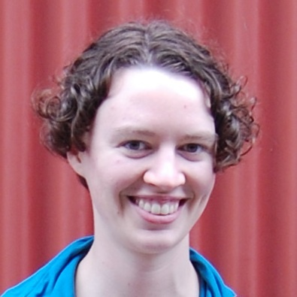
About Me
Tierney Smith Program Manager at TechSoup Canada @TierneyS

Slide 4
Agenda
Intro
Considerations:
Content
Design
Update-ability
Maintenance & support
Find-ability
Measurement
Q&A

Slide 5
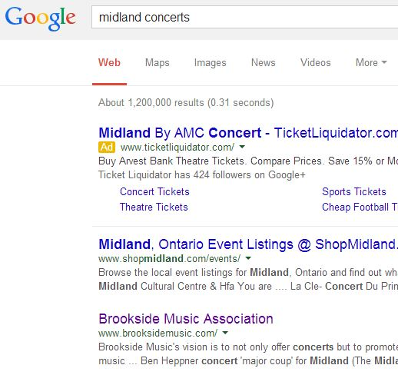
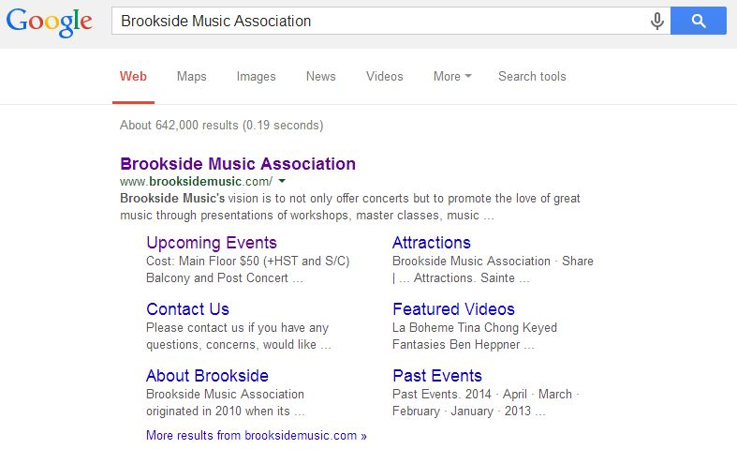
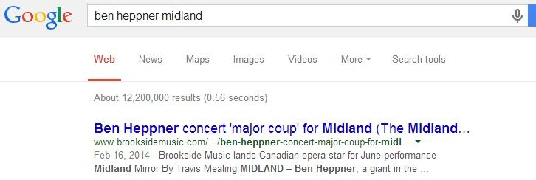
The Google Test

Slide 6
Your Website = Your Hub
Your Website
Email
Social Media
Word of Mouth
Customer Service
Radio
Newspaper
Brochure
Notes:
The only space you can control.
Links everything else. “Authoritative” source.
A FB page is not a good substitute. A page on a larger website is ok but not ideal.

Slide 7
Assess
No web presence
3rd party web presence
(page on another site, Facebook page)
Simple, static website
Dynamic, updated website
Notes:
“Dynamic” website category covers a wide range – even if this is you, there’s a lot of growth in this area

Slide 8
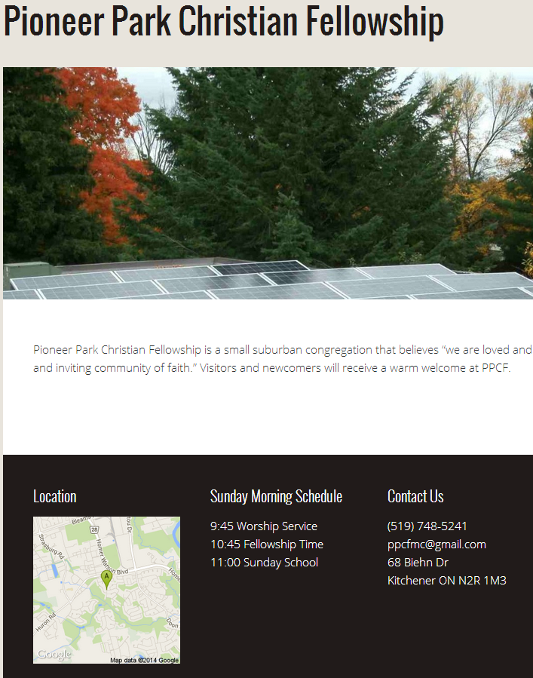

Slide 9
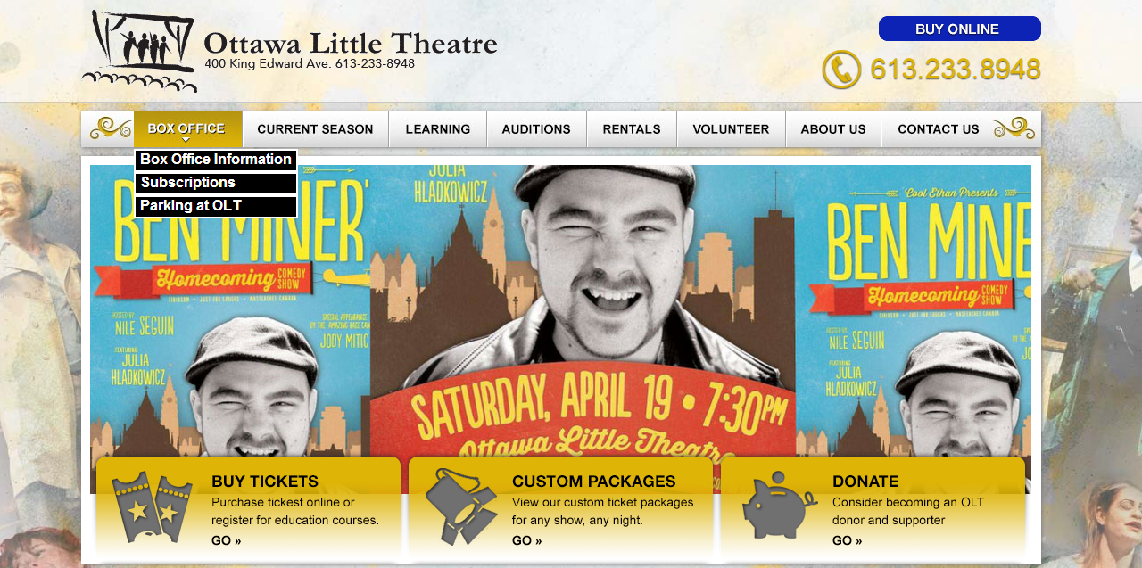

Slide 10
What level are you at with your website?
No web presence
Only a Facebook page
Page on another website
Simple website
Dynamic website

Slide 11
Content

Slide 12
It’s not about you!

Slide 13
#1: Who will visit your website?
Audience members
First-time visitors
Returning visitors
Season subscribers
Youth < 30
Donors
Volunteers

Slide 14
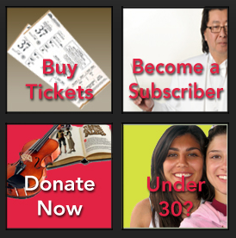
#2: What do your visitors want to do?
Find out about upcoming shows
Buy tickets
Donate
Look up your address
Contact you to find out about a show
Tip: go through this exercise for each of the types of visitors you identified in #1
Image from http://sudburysymphony.com/

Slide 15
#3: How can you make their lives simple?
Put information about upcoming shows front and centre
Include a menu item for “Contact Us”
Simplify, simplify, simplify (take out anything that isn’t key to visitors)
Tip: consider this question for each goal in #2

Slide 16
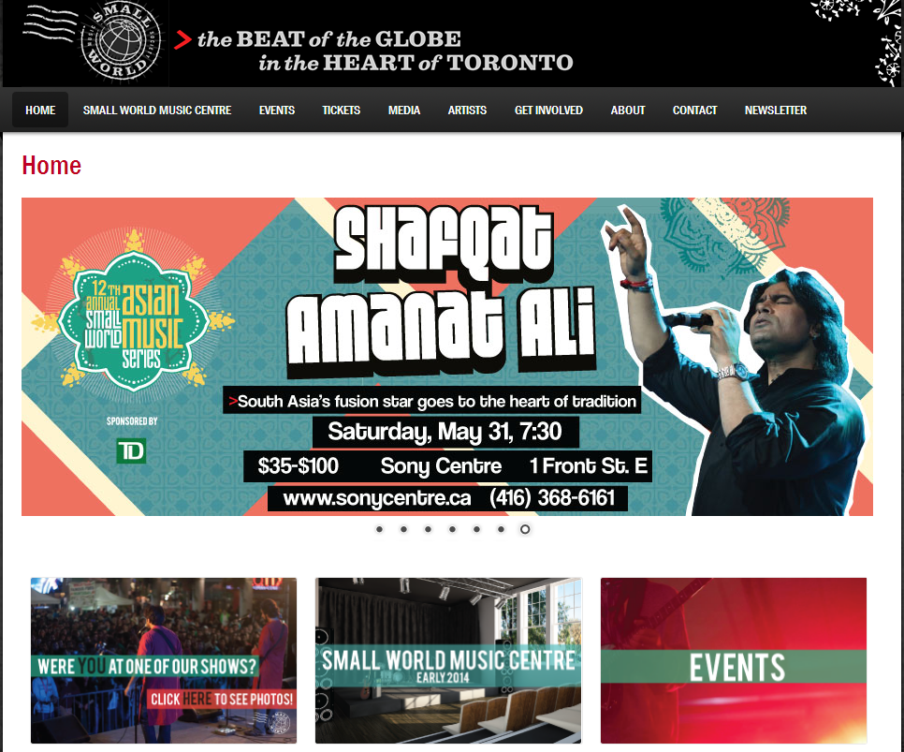
#4: What will get them to come back?
New/changing content
Upcoming shows
Upcoming events (camps, workshops, etc.)
Content related to shows/events e.g. video clip
Promotion on other channels

Slide 17
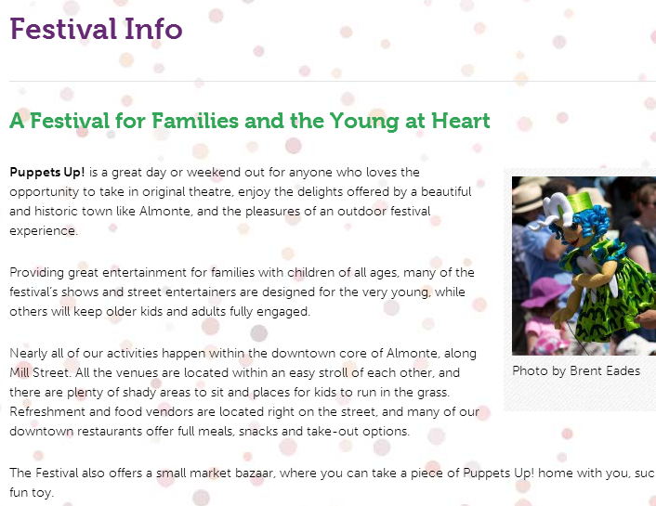
Must-haves
“About us” / who you are / what you do
Use clear, plain language
Contact info
Including venue info & map if applicable
Social media links & newsletter sign-up

Slide 18
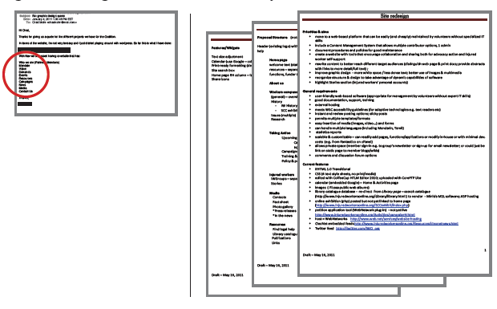
Summing it up: Be clear about your requirements
Notes:
In the first example, the charity just gave a list of 8 page titles on the website and nothing else. So it’s up to the consultant to make stuff up or there just isn’t anything there… how is this helpful? Your consultant may have no idea what you do.
In the second example, the charity had thought through the goals of their site and what it is they are trying to achieve. So they can send their consultant clear requirements, and they are more likely to get a site that they like and that works for them in the long run.
Note: the length of the instructions in the example doesn’t matter per se, it will depend on your website. Also, your consultant may help you to develop these.

Slide 19
Share 1-2 things that visitors want to do on your website.

Slide 20
Design

Slide 21
“Have nothing in your design that you do not know to be useful or believe to be beautiful.”
- William Morris

Slide 22
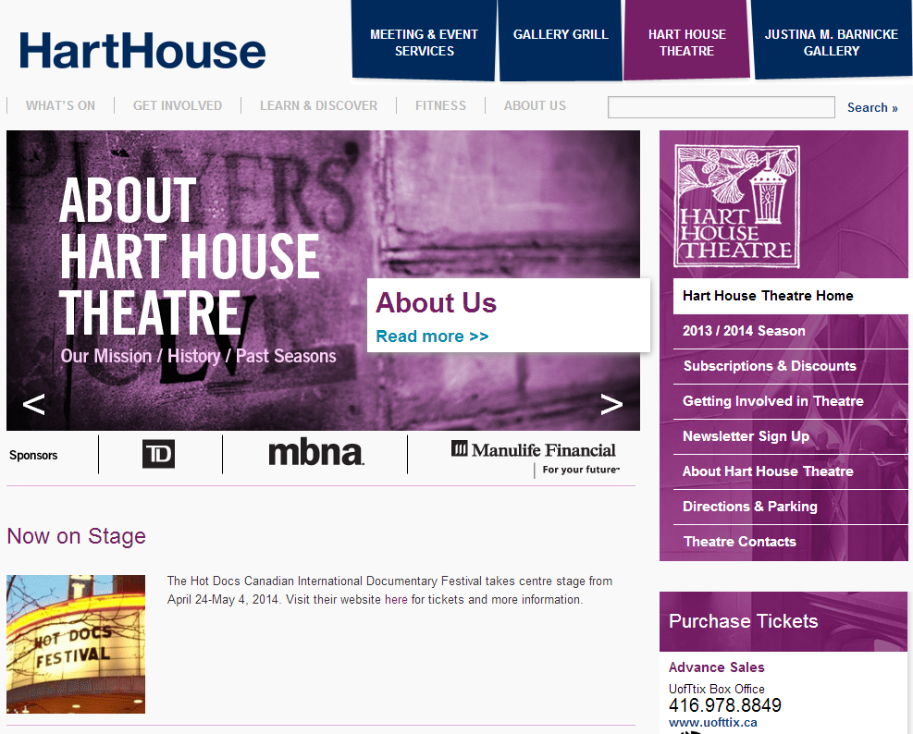
Keep it clean
Ask: what’s important to my audience?
You probably don’t need half of what’s on your home page
Make it clear where you want visitors to look

Slide 23
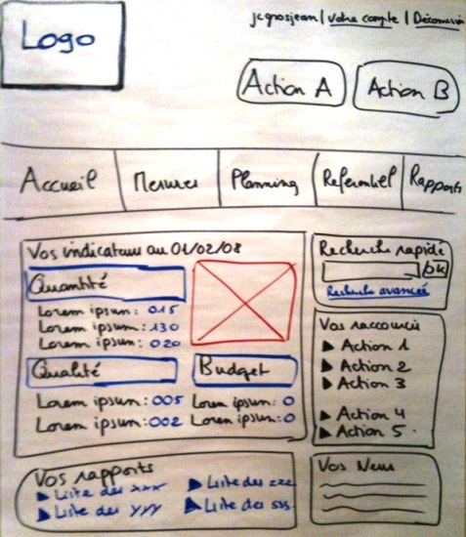
Test it out
Sketch out your idea (aka “paper prototyping”)
Get feedback from as many people as you can
See if they can find key info & actions
Nonprofit website navigation tips: http://wiredimpact.com/blog/nonprofit-website-navigation-tips-best-practices/

Slide 24
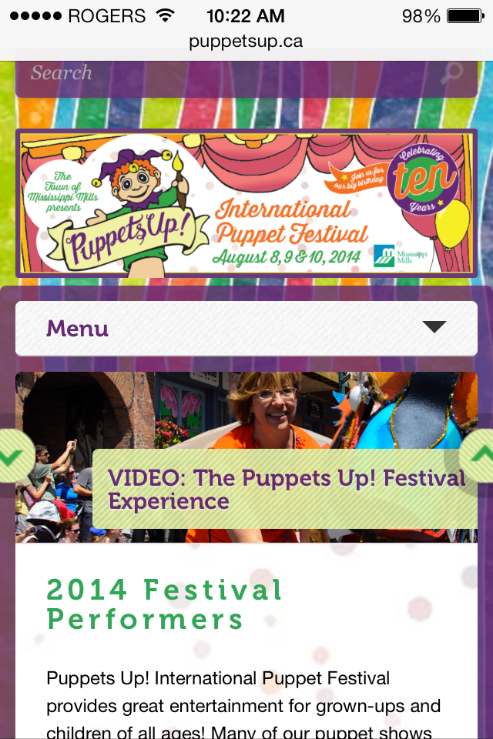
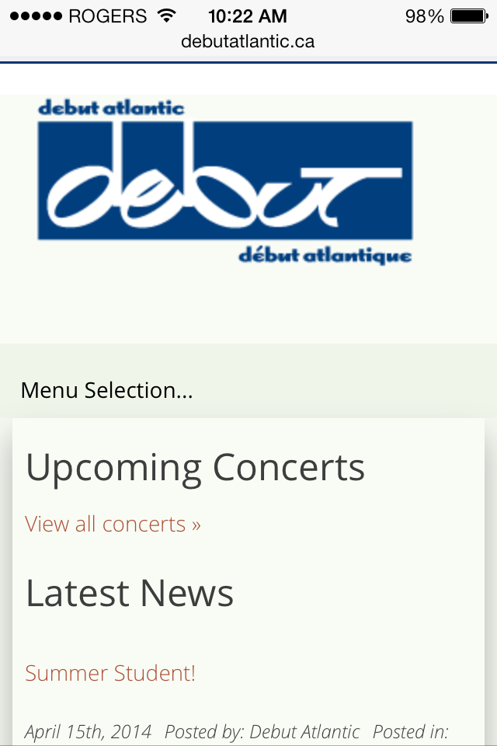
Make it mobile-friendly
https://www.techsoupcanada.ca/en/learning_centre/articles/optimizing-your-nonprofit-website-for-mobile

Slide 25
Update-ability

Slide 26
Content management systems (CMS)
CMS
Training
You have control!
Notes:
When I ask nonprofits/charities how they update their website, often the answer is “call our tech guy” or “ask our tech volunteer”. It shouldn’t be this way… you should be able to update your site when you need to!!
Note: for many websites, there will be some things that you can’t edit yourself. Maybe you can edit the text on a page, but not the overall design. This will depend on the CMS and how it is configured (roles/permissions).
Demo of TechSoup Canada site, editing a page

Slide 27
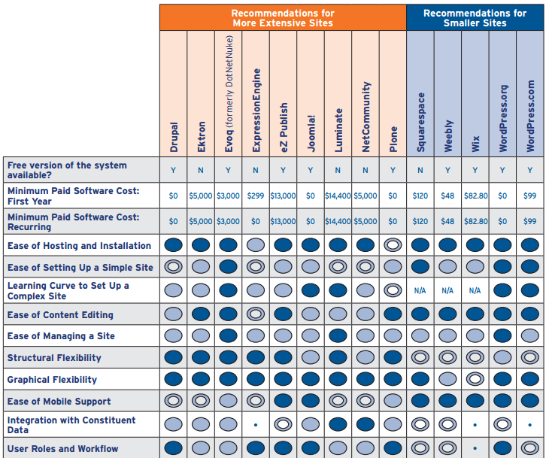
How to pick a CMS?
Commercial (free or monthly fee) vs. open source (free)
Cost to acquire vs. cost to implement
Current needs vs. future needs
Nonprofit guide to CMS: http://www.idealware.org/reports/consumers-guide-content-management-systems-nonprofits

Slide 28
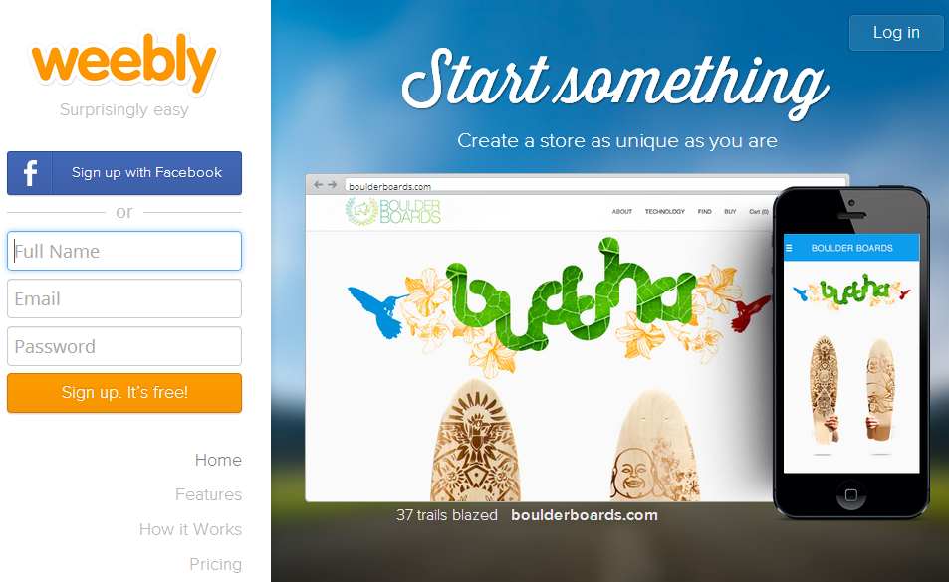
Weebly
Build your site with drag and drop
$4/month to use your own domain
Great for simple and attractive websites without too much complex functionality

Slide 29
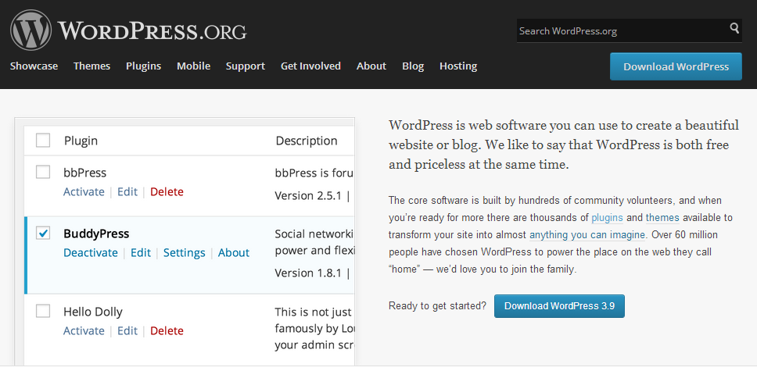
WordPress
Free, open source
Many plugins available – can add a lot of functionality
Helps to be a bit tech-savvy or have someone with WordPress experience
Walkthrough on how to set up a nonprofit WordPress website:
http://nonprofitally.com/make-a-nonprofit-website

Slide 30
Support & Maintenance

Slide 31
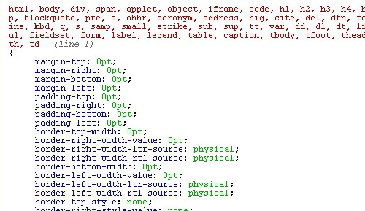
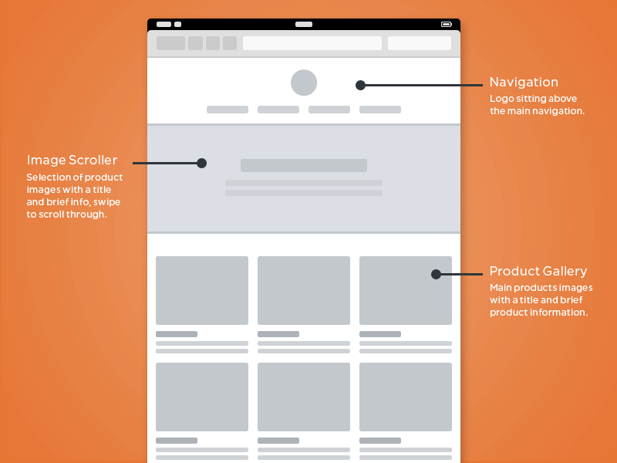
Find the right skills
Geek
Designer

Slide 32
Who you gonna call?
Know where you can get ongoing help
CMS provider
Website developer
Reliable volunteer
To deal with:
Applying patches/upgrades
Fixing issues
Adding new features

Slide 33
Budgeting Tips
60% guideline
If working with consultants, give them a budget that is 60% of your actual budget
Ongoing budget
Put a line item in your budget for ongoing website support & maintenance
Plan for improvements
Budget for a website refresh every 3-5 years
Notes:
Ottawa Little Theatre had to get the board to approve a large amount when they did a major overhaul of their site 5 years ago, to turn it from a static and boring site into something more dynamic. From then on she puts a smaller amount for upgrades and improvements each year.
Getting board approval -> this was part of a larger initiative to move to new box office software, upgrade hardware – part of a larger investment in technology

Slide 34
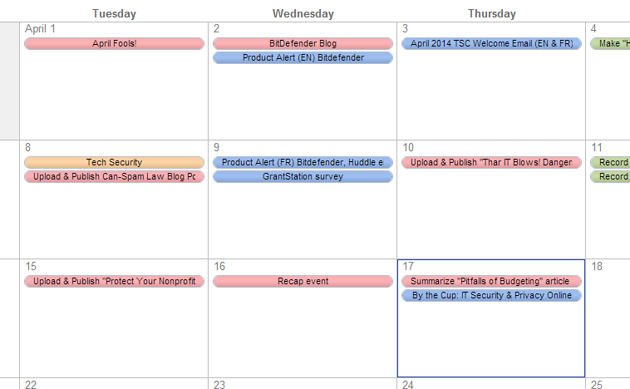
Keep it fresh
Schedule content updates
Tie it to existing activities:
New show
Sending newsletter
Advertising in newspaper
New season announced
Which content to update weekly / monthly / seasonally?
Notes:
Ottawa Little Theatre – change the content for every show, 9 shows/year

Slide 35
Find-ability

Slide 36
Goal: be found in a Google search
Known as “Search Engine Optimization” or “SEO”
“Keywords” = words & phrases that people type into a search engine
Speak your audience’s language
Focus on your niche
Bottom line: make your website useful and relevant for your audience
Keyword research tool: https://adwords.google.com/KeywordPlanner
More about SEO: http://www.techsoupcanada.ca/community/blog/toronto_net_tuesday/seo

Slide 37
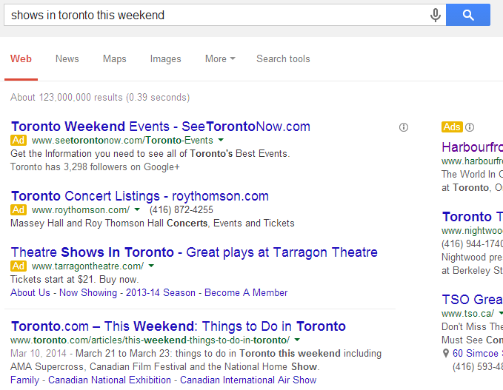
Online advertising
Search engine marketing (SEM) = ads related to search engine keywords
Google Adwords
Google Grants (for charities)
Banner ads = ads on other websites
Notes:
OLT has started trying out ads, very preliminary but promising results so far

Slide 38
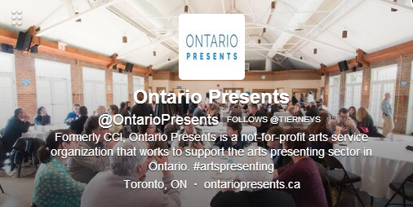
More ideas
Think of your website like your name or contact info – it should be on everything
Put your website address:
In printed promotional materials e.g. poster, brochure, newspaper ad
In printed programmes
On your social media profiles
In online event listings
http://www.fundraising123.org/article/driving-traffic-your-nonprofit-website

Slide 39
Measurement

Slide 40
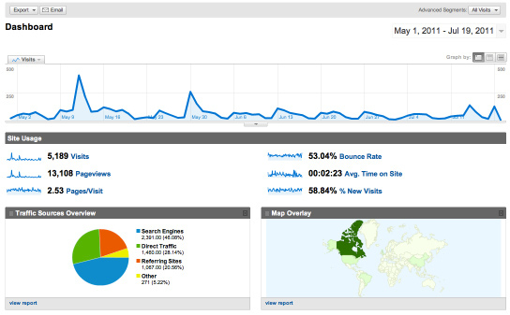
Install Google Analytics
Notes:
Idealware and others have reviewed multiple tools; the bottom line is that Google Analytics is easy, free and extremely powerful.
Adding Google Analytics is very simple (inserting 5 lines of HTML), your developer can probably do it tomorrow
-do this ASAP with your current site and make sure it is there from day 1 with a new site
-Worker’s Action Centre example – big spikes when they were on the front page of the paper, little spikes when they send out a newsletter
-show our Google Analytics for TSC site?
->how to find out how many people are coming from a mobile?

Slide 41
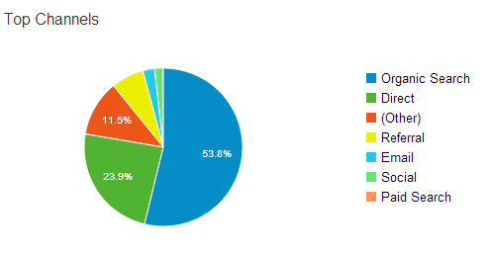
Important data to track
# of visitors to your website
# views of key pages
Which are your most popular pages?
Location – where are your visitors?
Traffic sources – where are your visitors coming from?
Google search, email campaign, link from another website, directly typing the URL into their browser, etc.
A bit more advanced: http://wiredimpact.com/blog/website-data-nonprofits-should-track/

Slide 42
Goals & Campaigns
Goals: did your visitor do the thing you wanted them to do?
Buy a ticket
Donate
Campaigns: get detailed info about which of your campaigns are producing results
Use campaign tracking links (which are way less complicated than they look):
http://www.techsoupcanada.ca/Microsoft/windows-8-is-here?utm_source=customer_service&utm_medium=email&utm_campaign=email_signature
Learn more:
http://www.npengage.com/online-fundraising/setting-goals-google-analytics/ (note that screenshots are out of date)
http://embracewp.com/google-analytics-help-set-goals/
Create campaign tracking links: https://support.google.com/analytics/answer/1033867?hl=en

Slide 43
Questions? Comments?
www.techsoupcanada.ca
@techsoupcanada
facebook.com/techsoupcanada

Slide 44
What is one next step you plan on taking after this webinar?

